Slide 1


My Projects
Konstantina

Slide 2
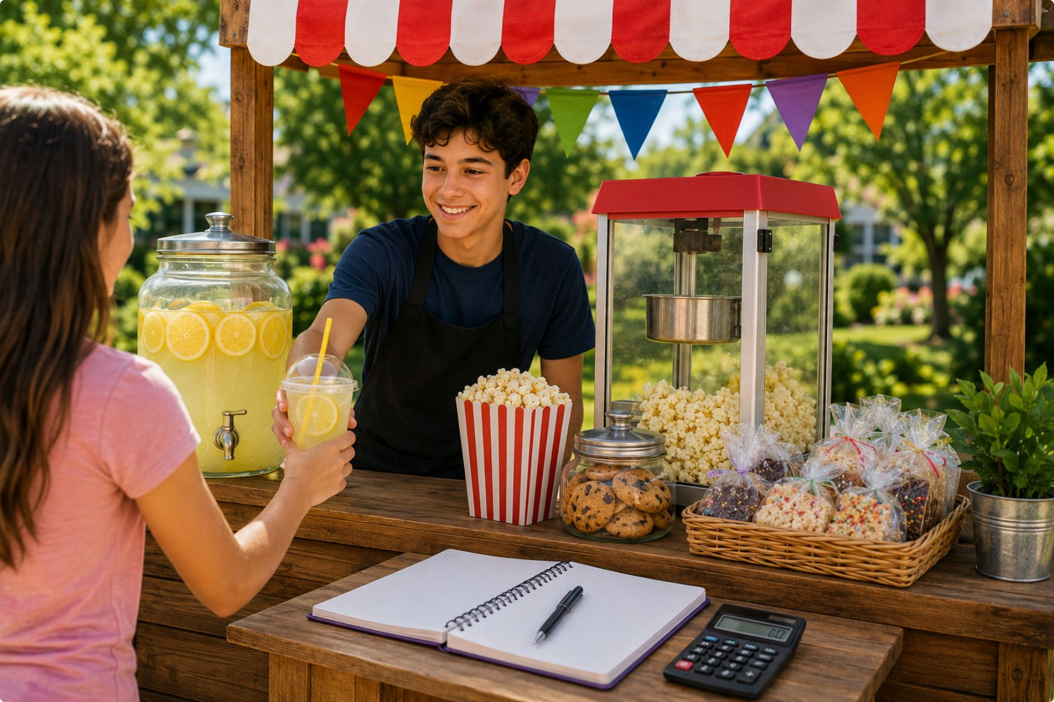
1- Project idea
Snack Stand
Sell cold drinks, lemonade, popcorn, or homemade treats (if allowed in your area).
Track your costs, sales, and profits in a notebook.
Goal: Learn budgeting and earn a profit over the summer.

Slide 3
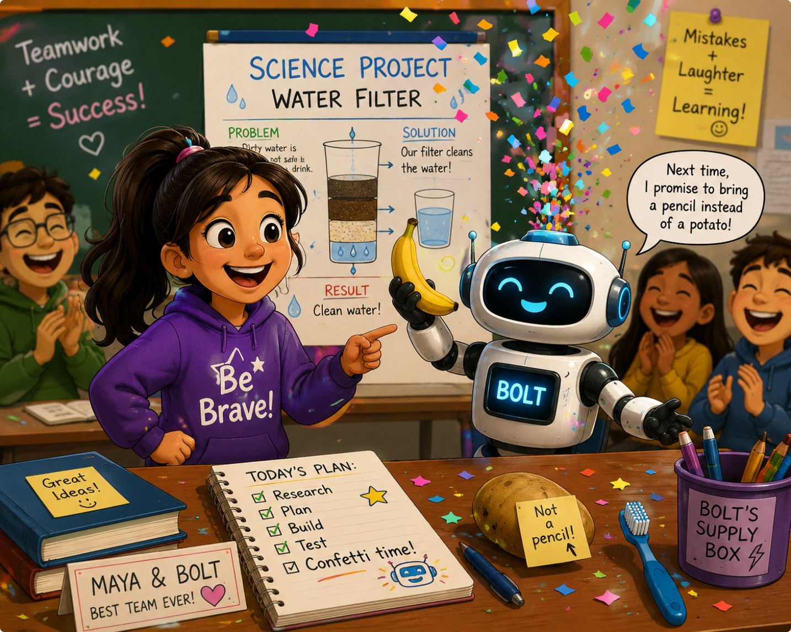
2- Ai for writing
The brave student and the helpful robot
This is a story about a helpful robot and a brave student

Slide 4
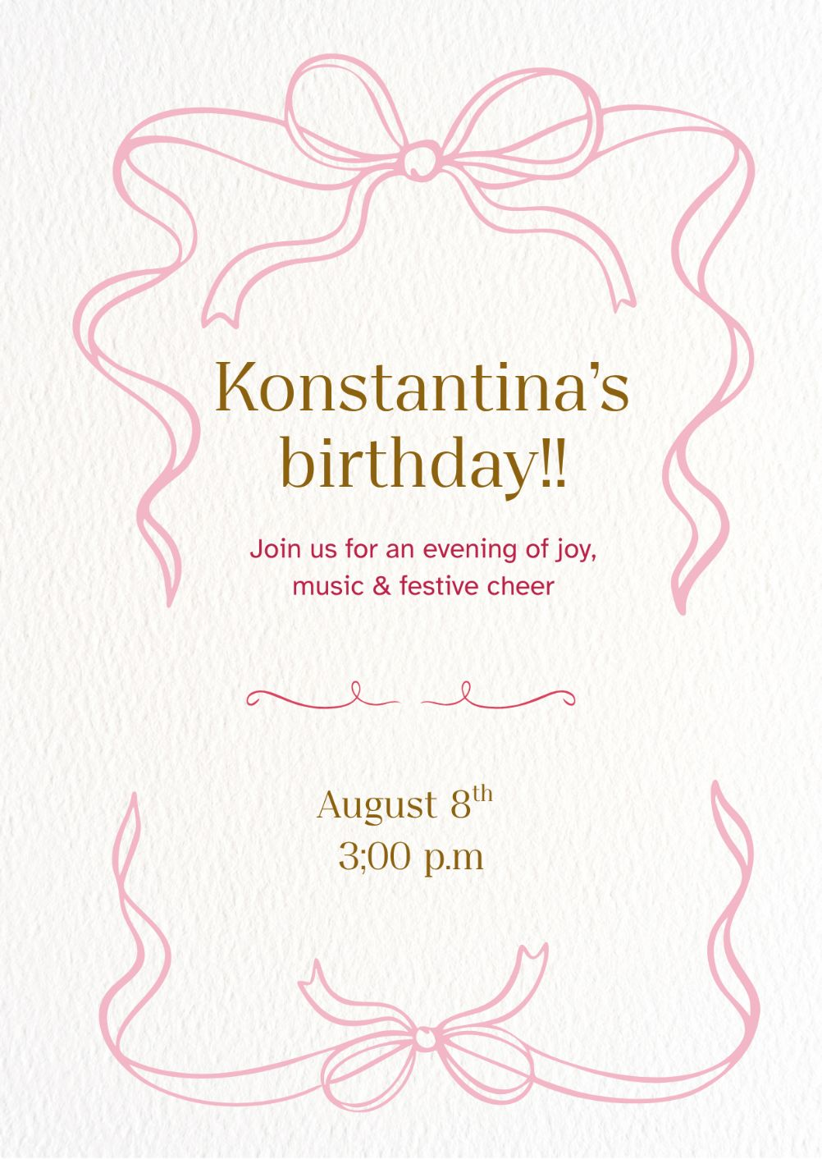
3- Ai for graphic design
Birthday Card

Slide 5
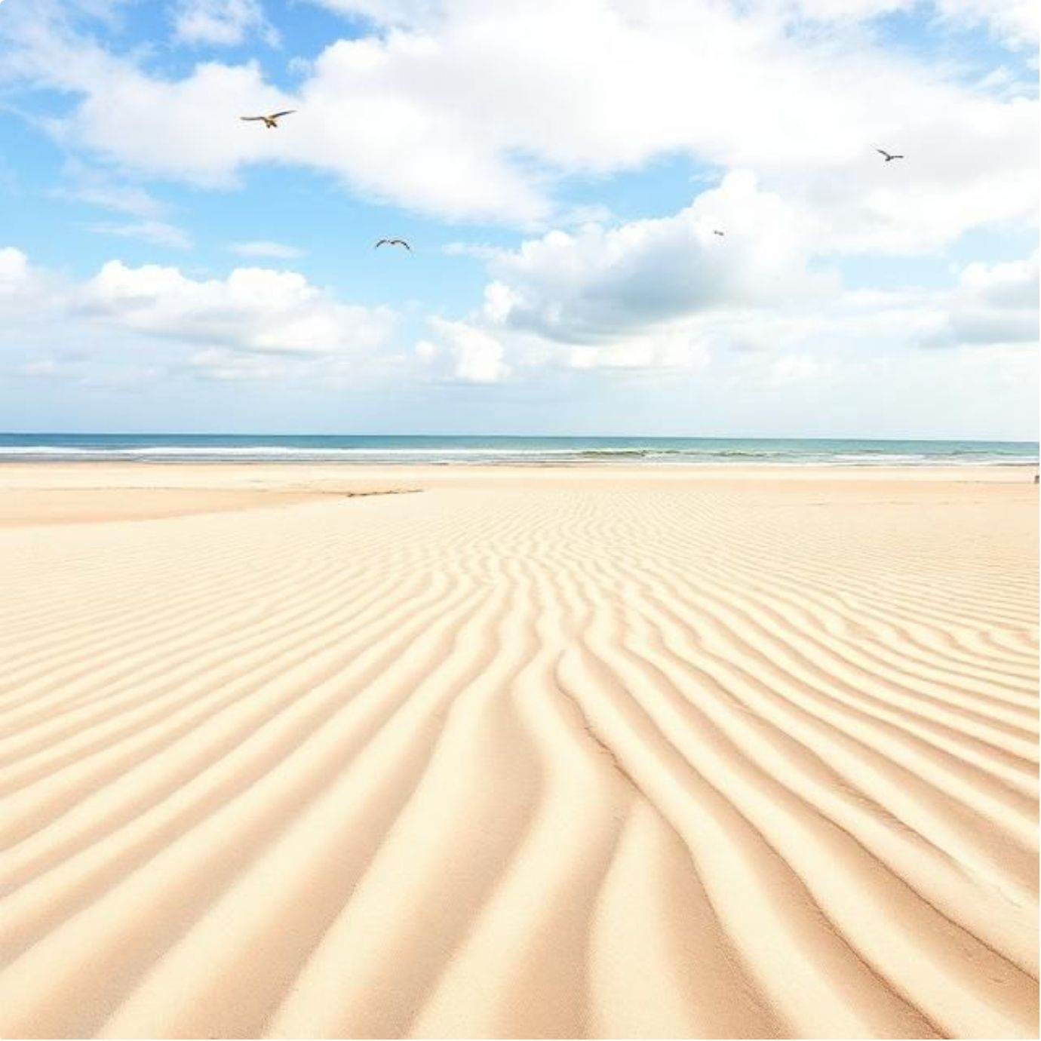
4- Ai for Image
About Beach

Slide 6
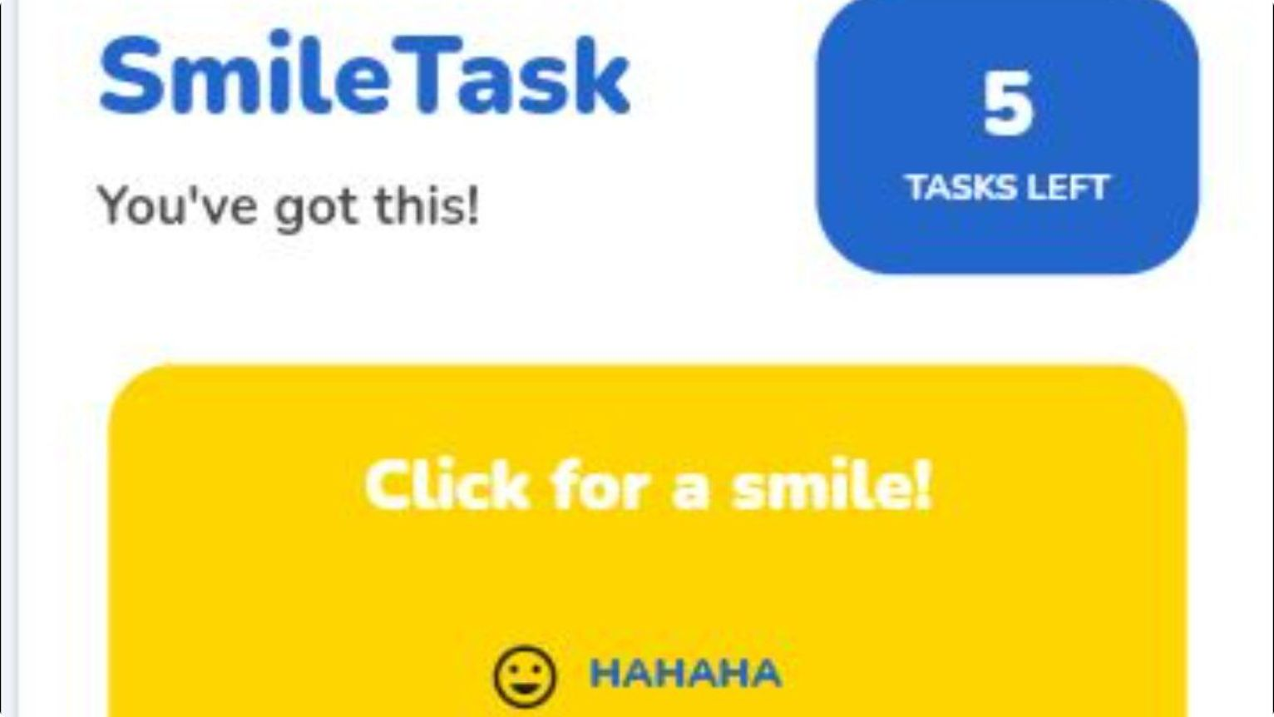
5- Ai for Mobile App
My TASKS AND jokes button

Slide 7
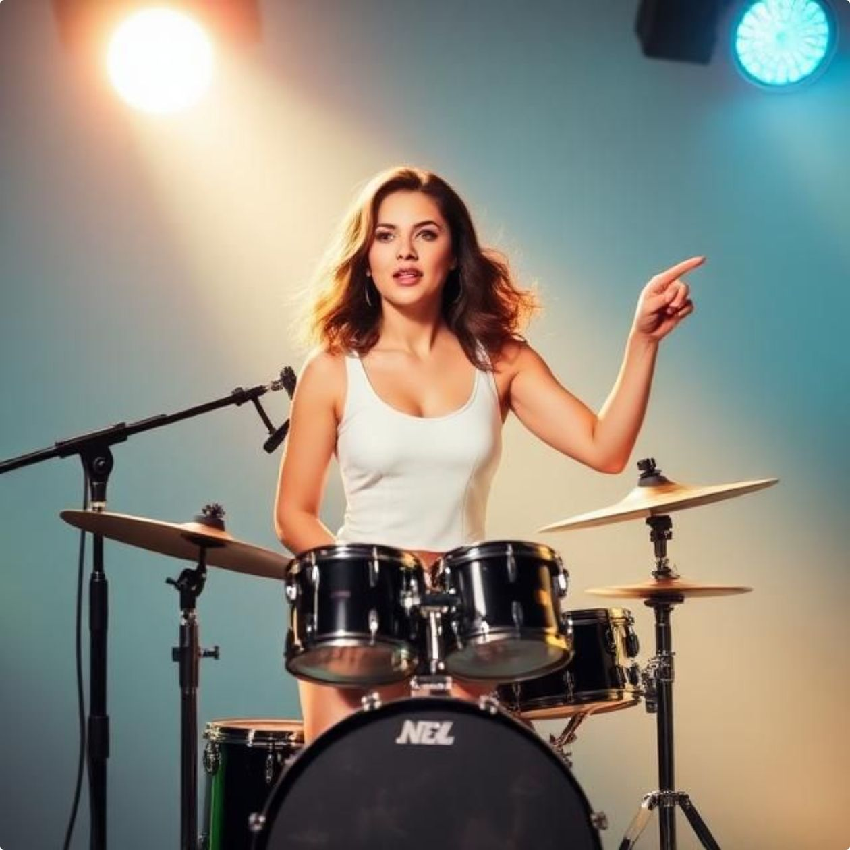

6- Ai for Music
Pop Song

Slide 8
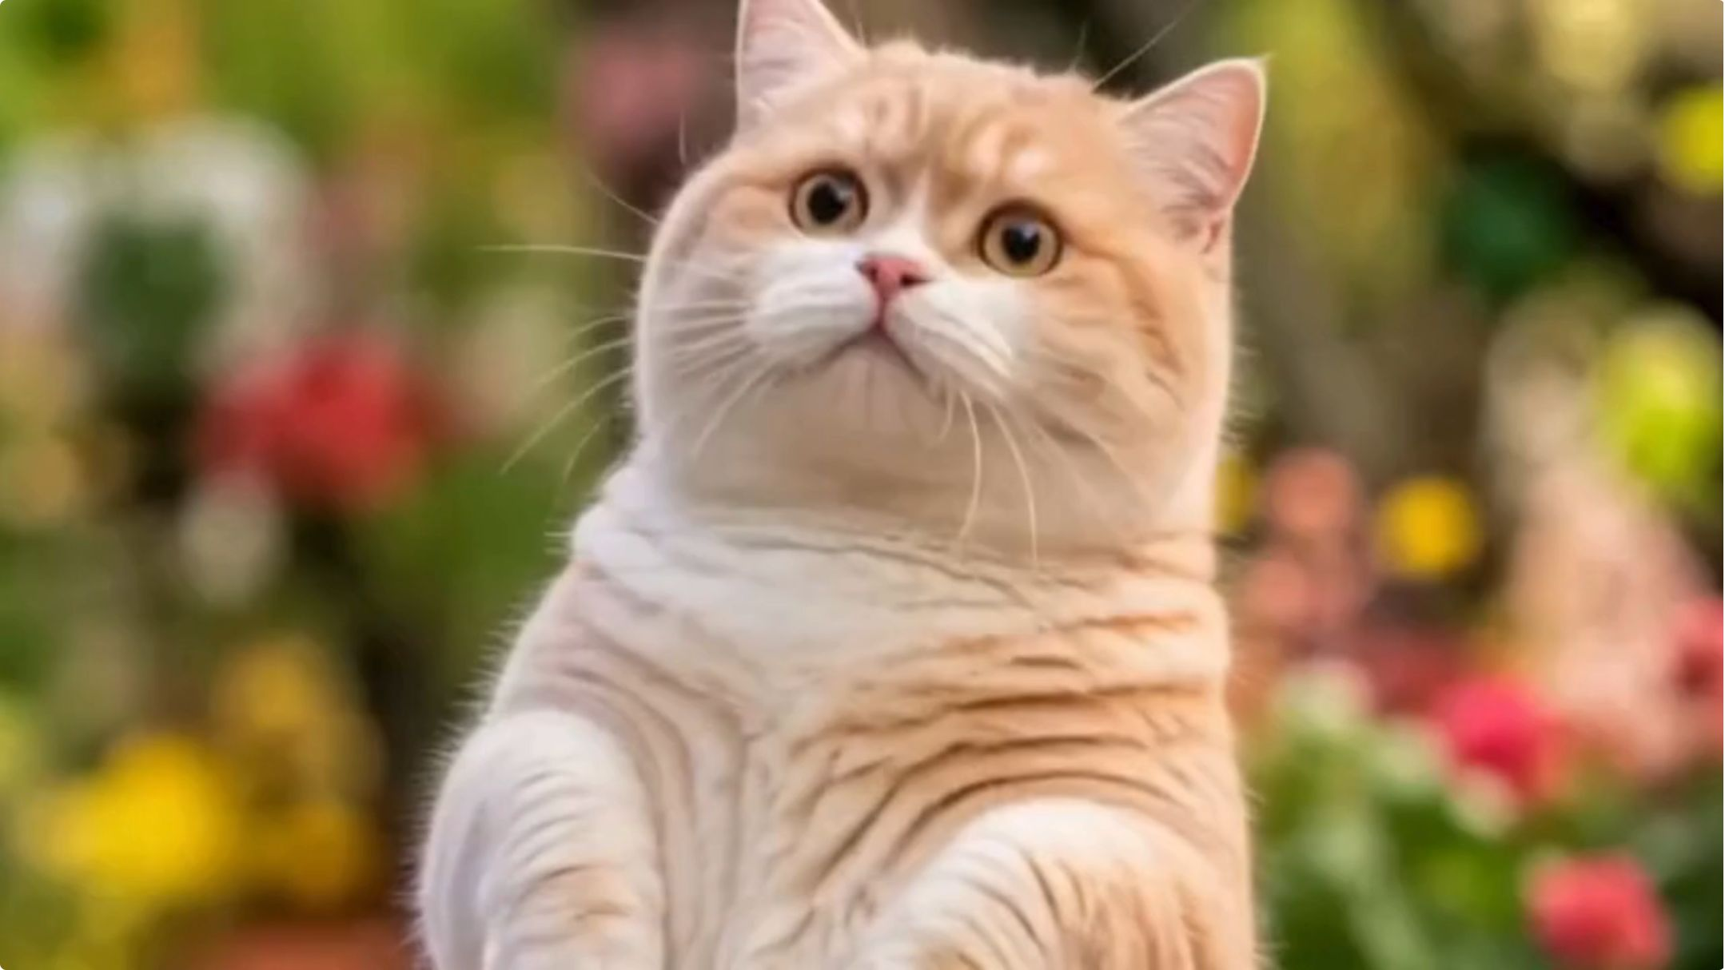
7- Ai for Video
About a cat looking

Slide 9
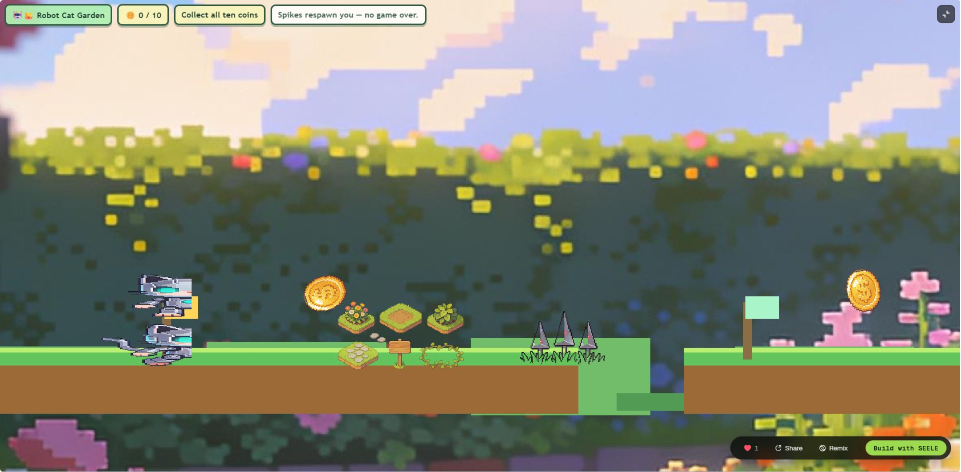
8- Ai for Game
Platformer game

Slide 10
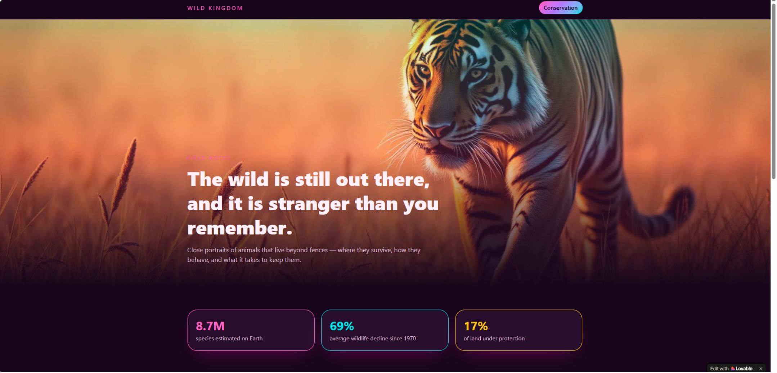
9- Ai for Website
Website about wild animals

