Slide 1

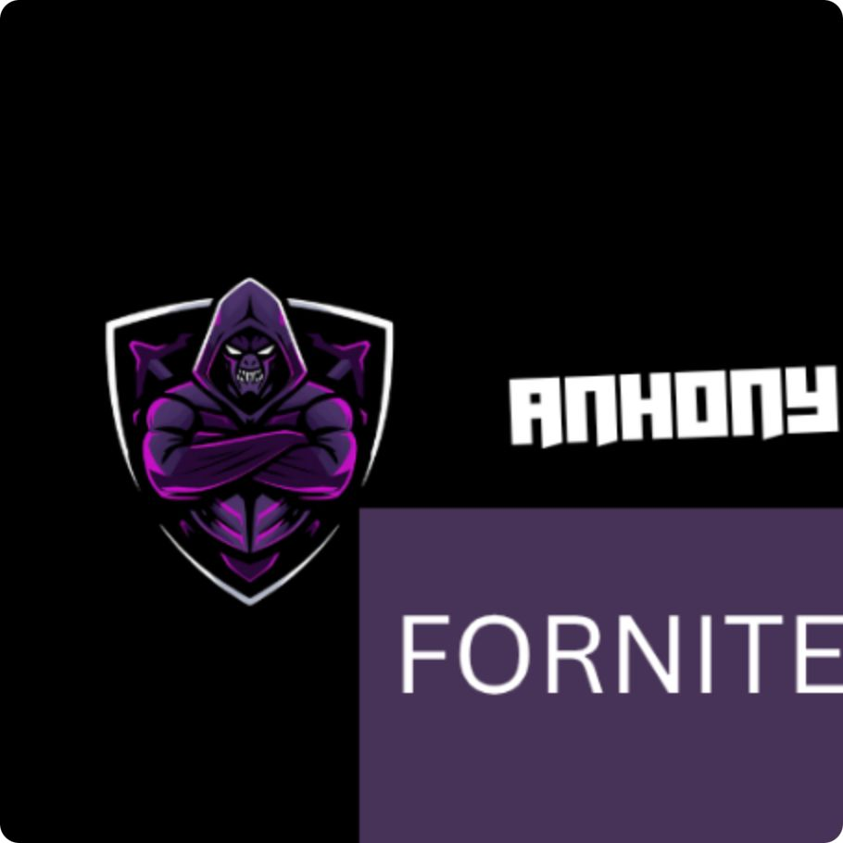
MY PROJECTs
ANTHONY Al Rahi

Slide 2
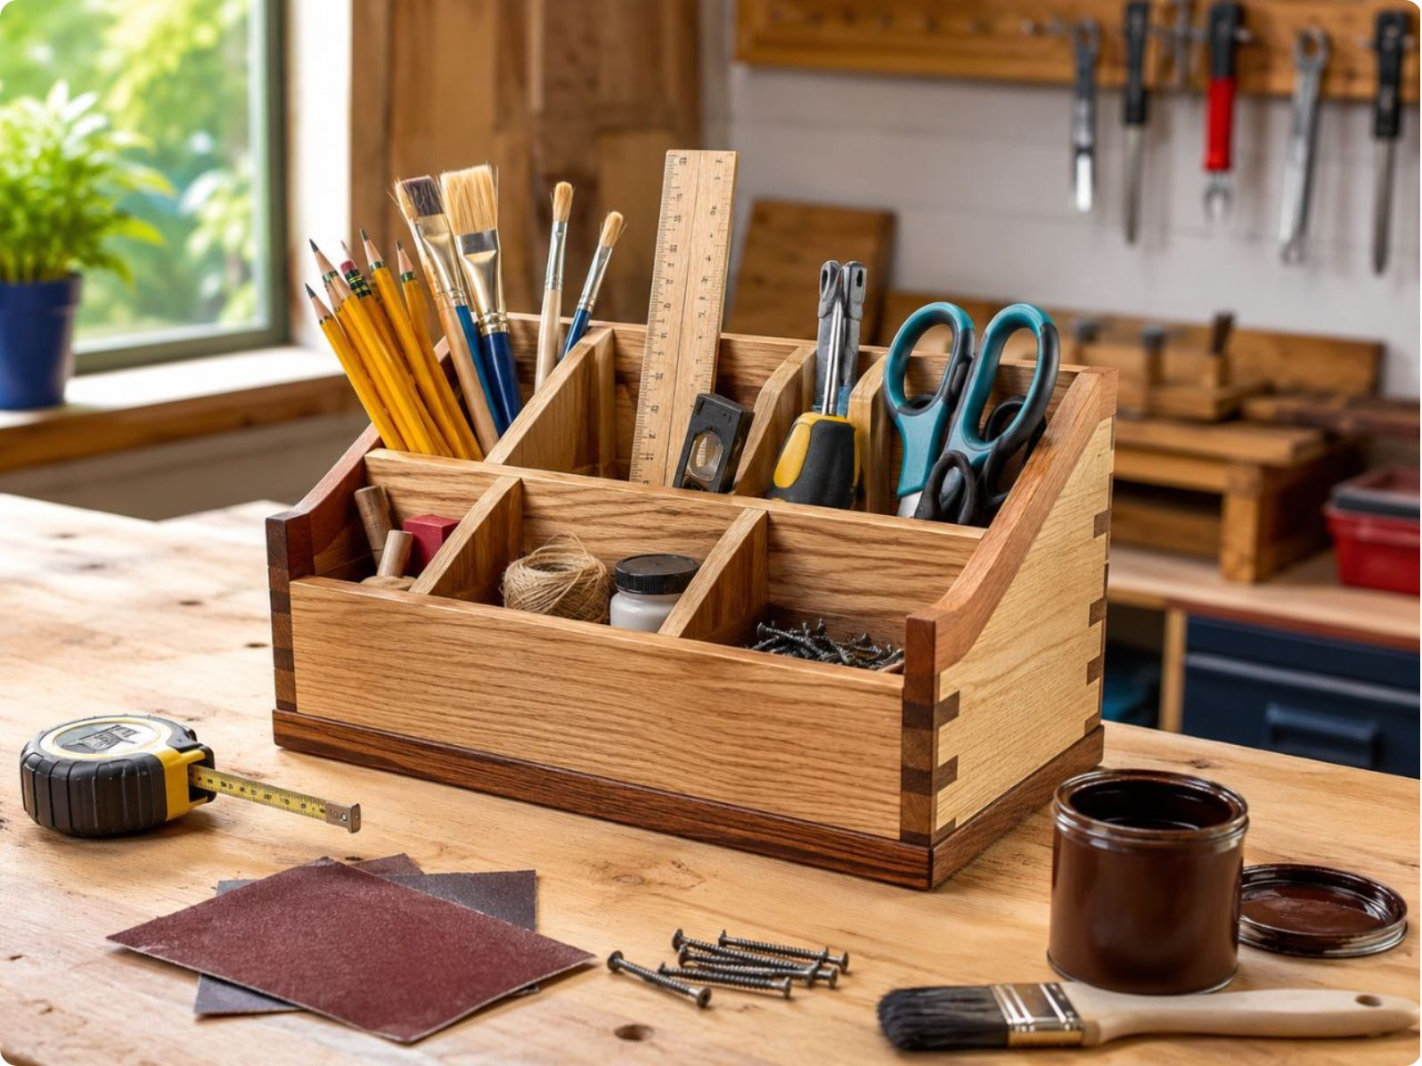
1- Project idea
Build
My project helps people build

Slide 3
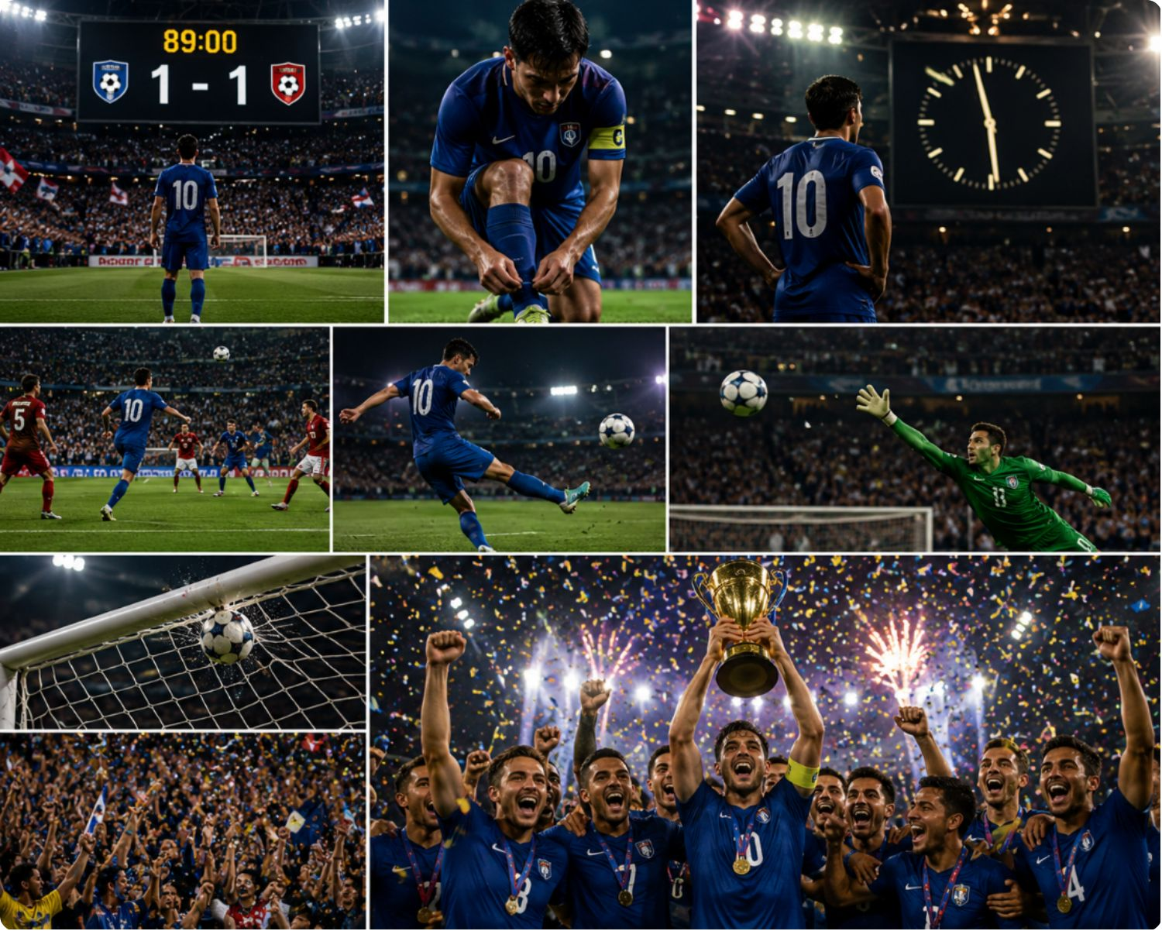
2- AI for Writing
A story
My project helps people follow the football

Slide 4
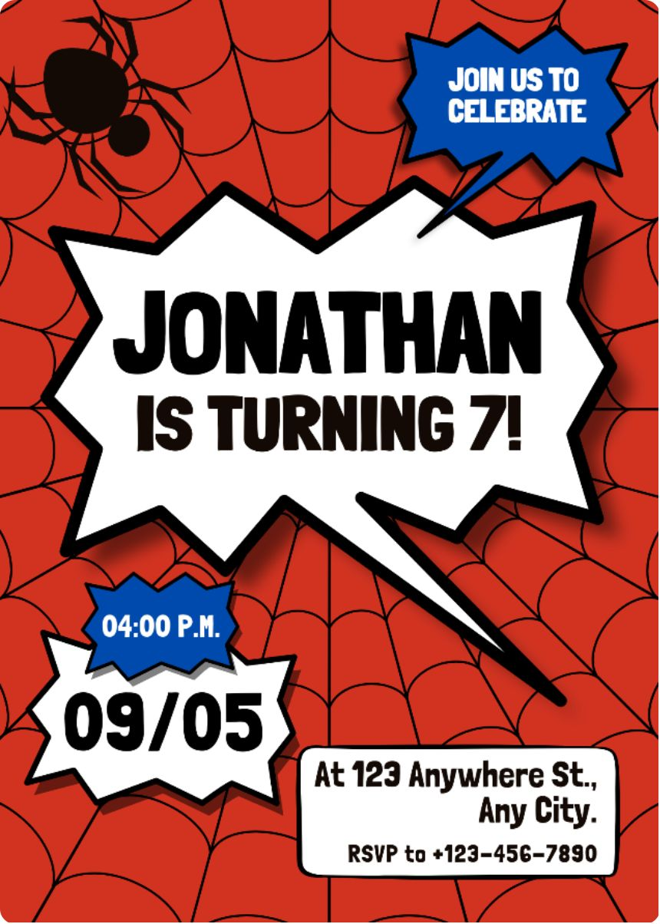
3- AI for Graphic Design
An invitation card
My project helps people to be informed about an event

Slide 5
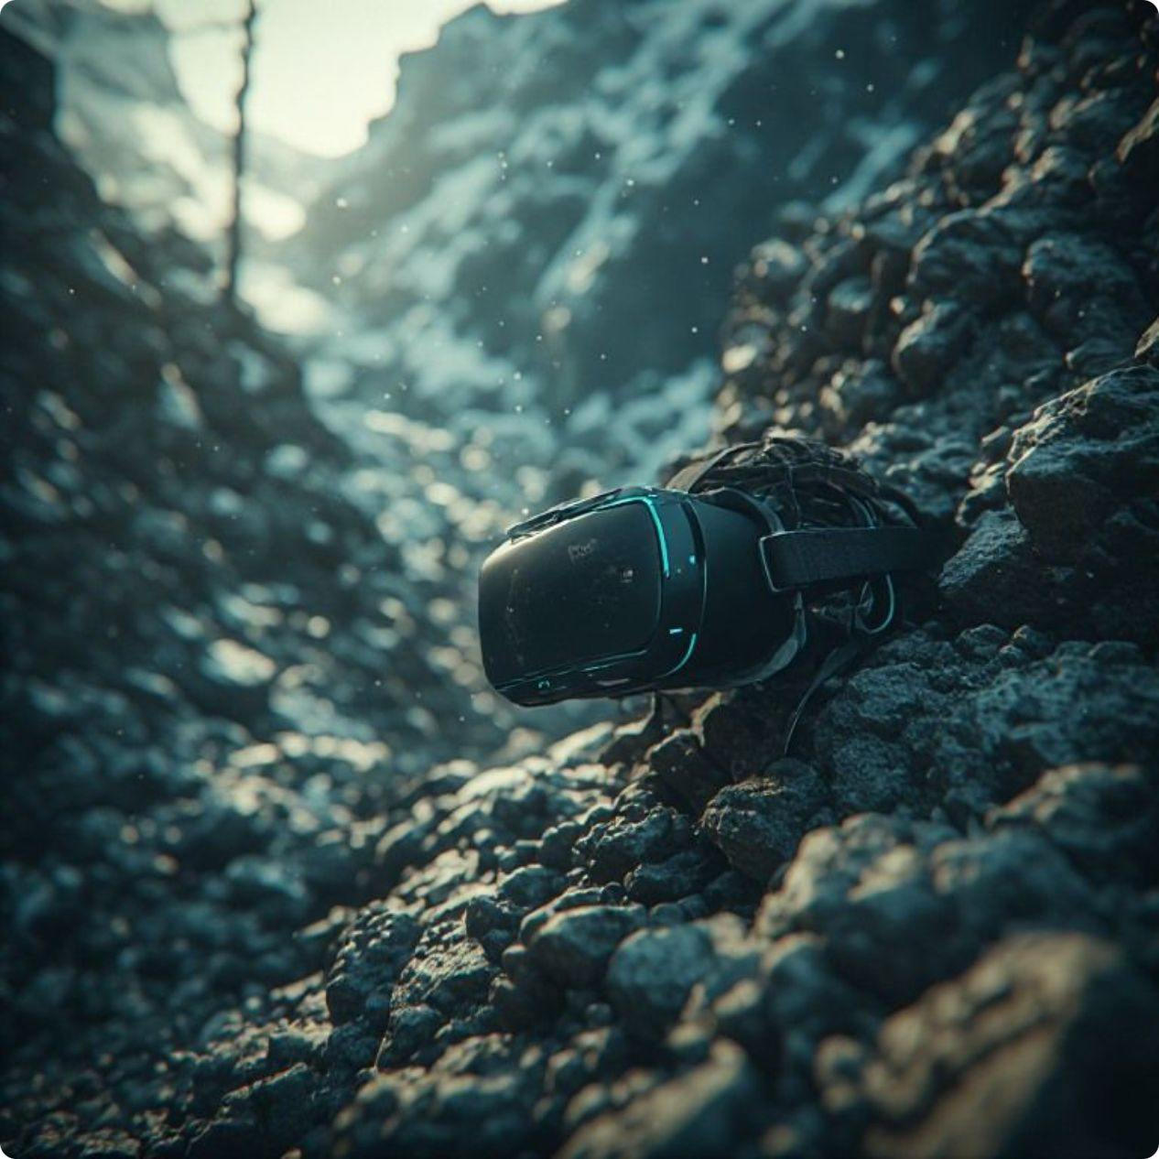
4- AI for Image
VR device under the ocean
My project helps people enjoy the visual creation

Slide 6
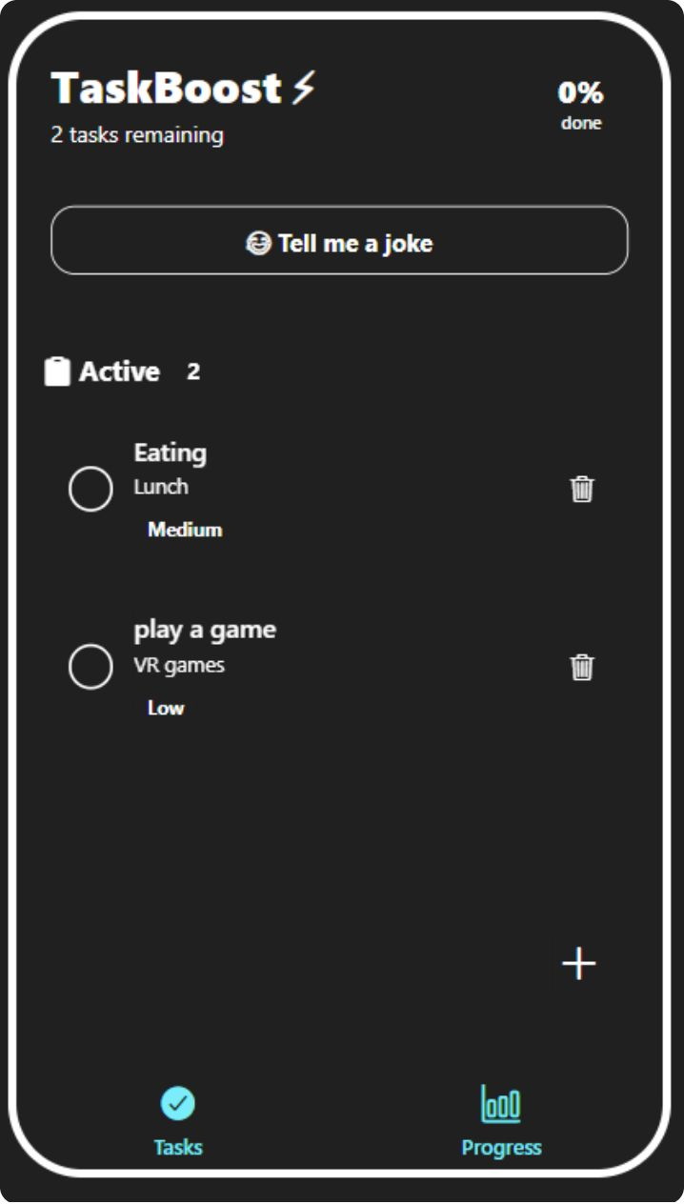
5- AI for Mobile App
Tasks and Mood Booster
My project helps people organizr their time

Slide 7
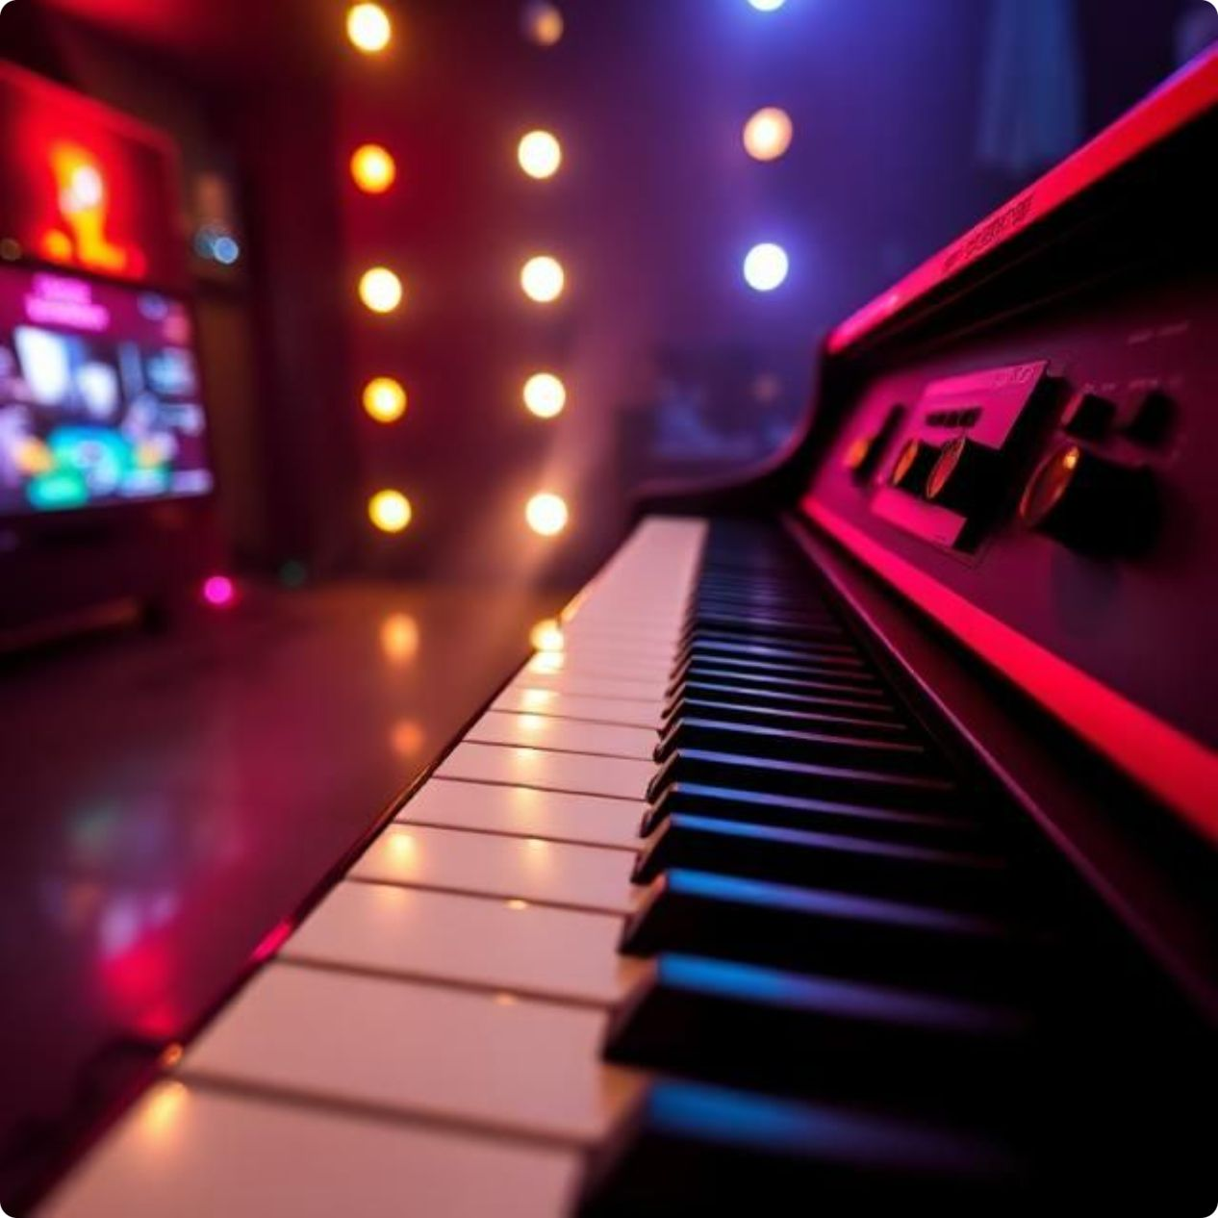

6- AI for Music
Song about VR games
My project helps people enjoy music

Slide 8
7- AI for Video
Video about VR games
My project helps people enjoy video

Slide 9
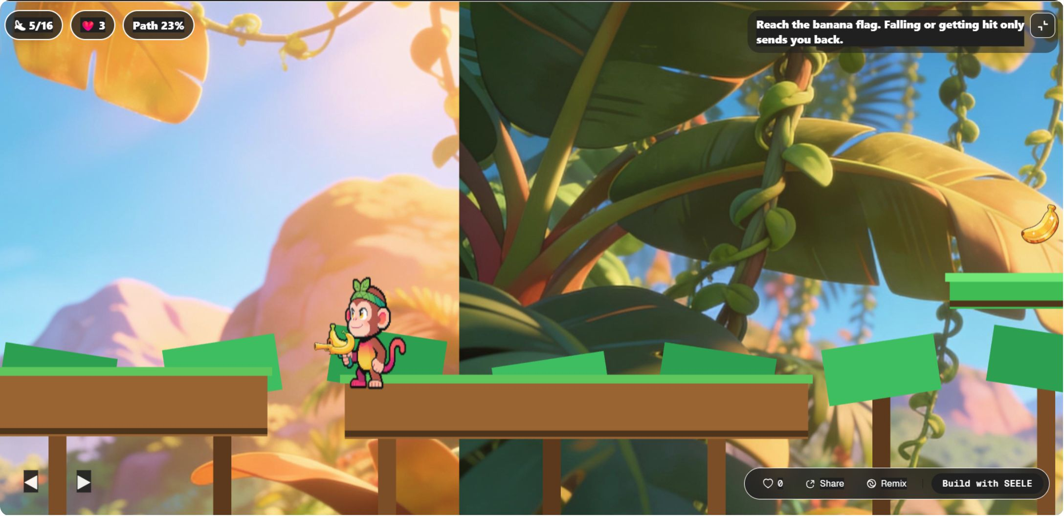
8- AI for Game
Platformer Game about a Monkey collecting bananas
My project helps people enjoy the game

Slide 10
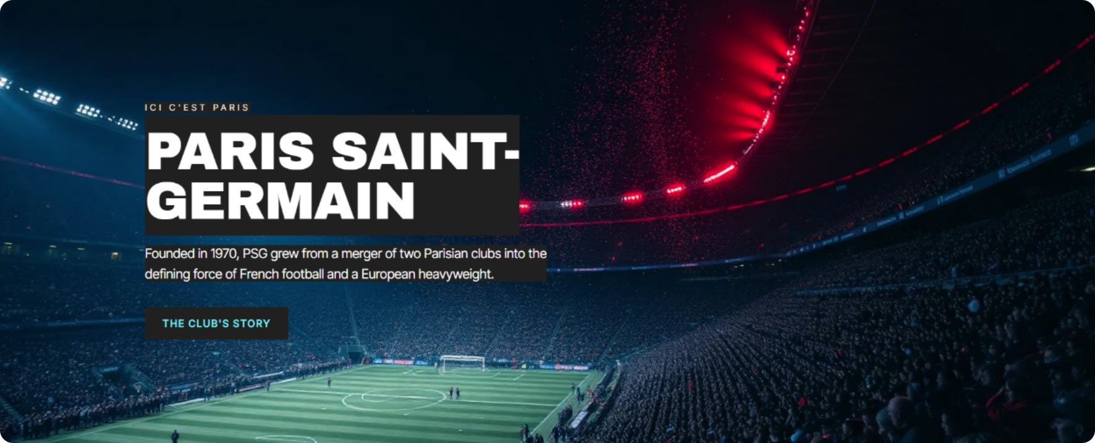
11- AI for Website
Website about PSG
My project helps people read about PSG

