Slide 1
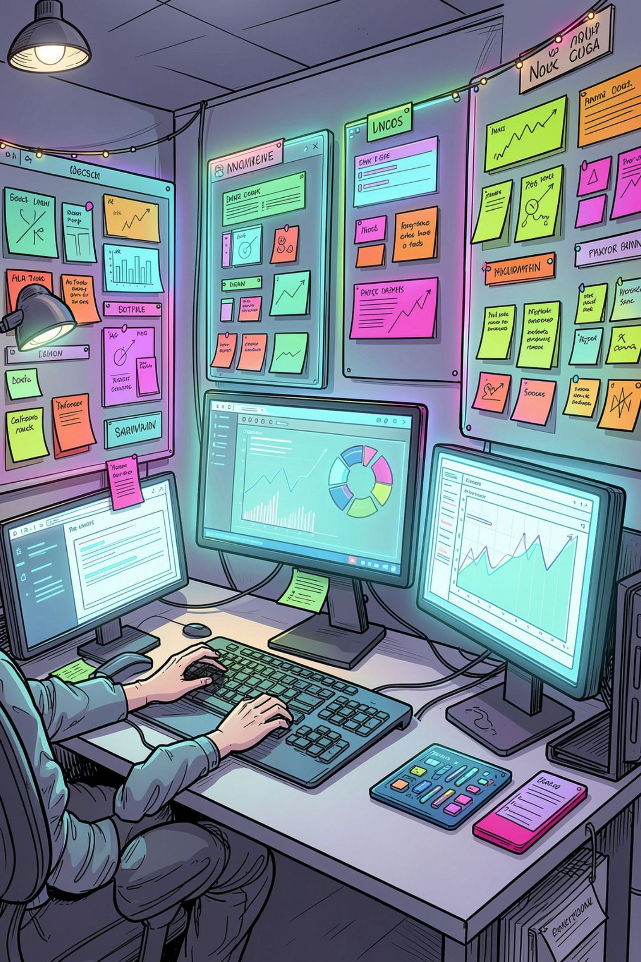
MY PROJECTS
Eva Costa

Slide 2

TABLE OF CONTENTS
01
02
03
1-Project idea
2- Ai for writing
3- Ai for Graphic Desighn
04
05
06
Ai for image
Ai for music
Ai for Website
07
08
09
Ai for Mobile app
Ai for game
Ai for video

Slide 3
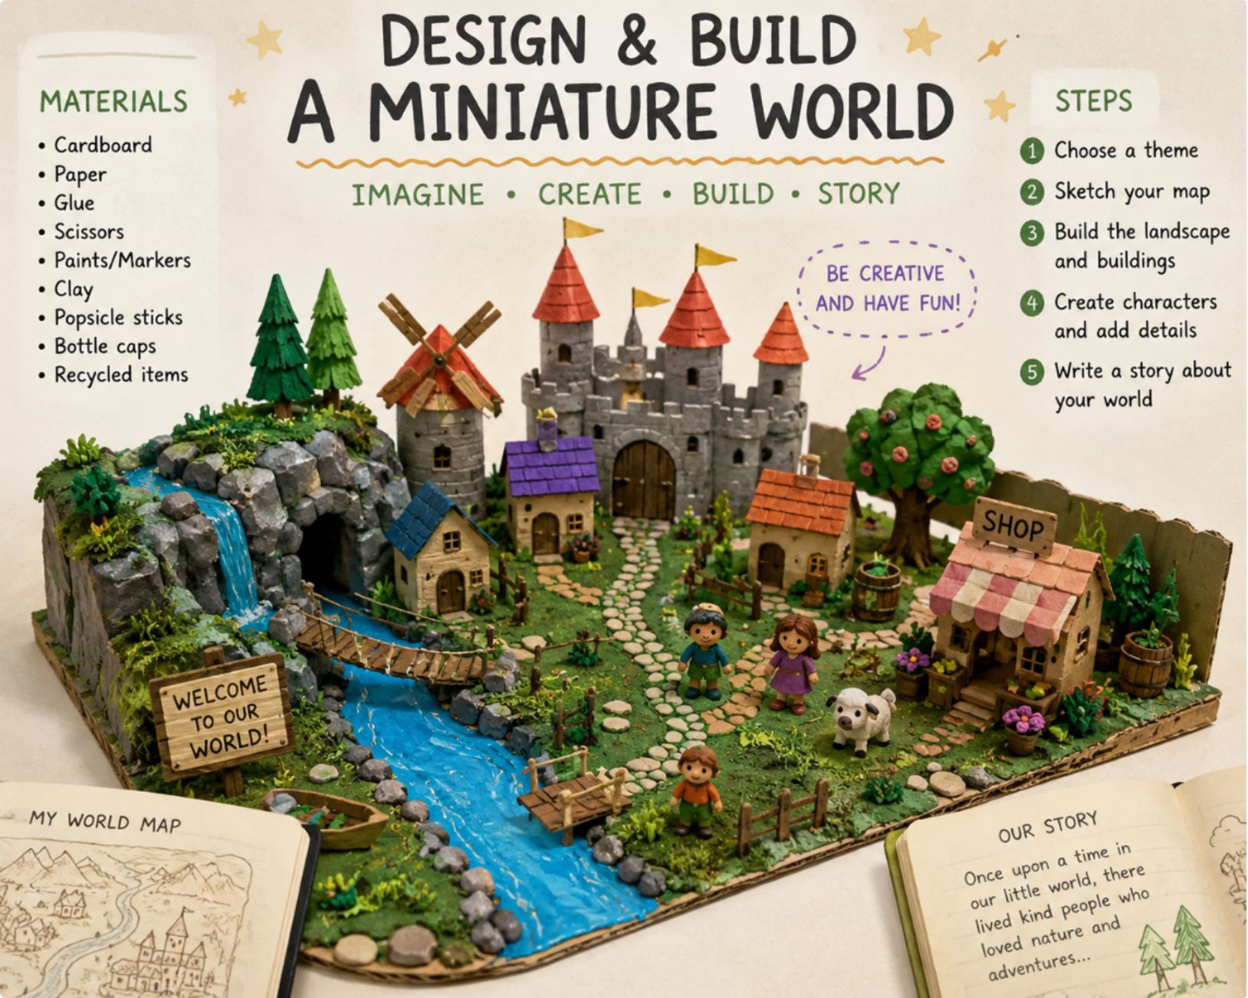
1-Project idea

Slide 4
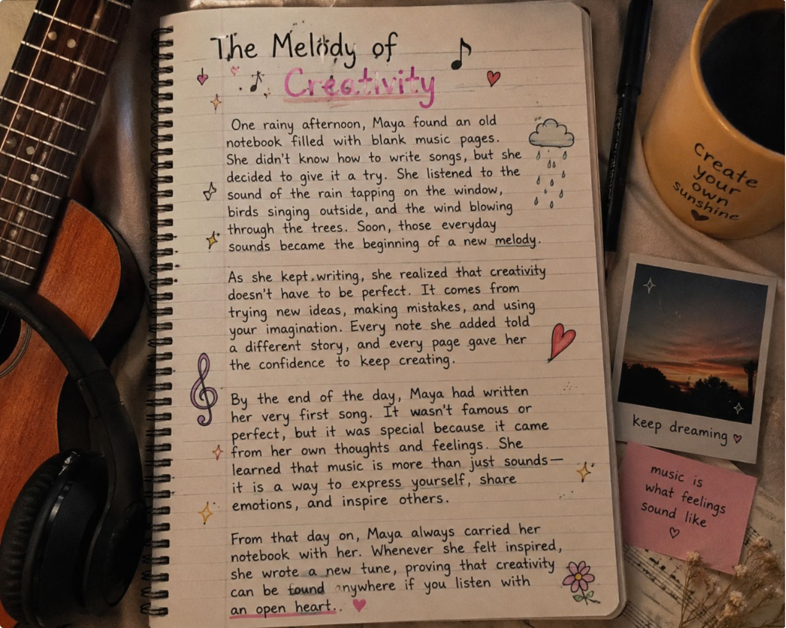
2-AI for writing

Slide 5


3-AI for Graphic design

Slide 6
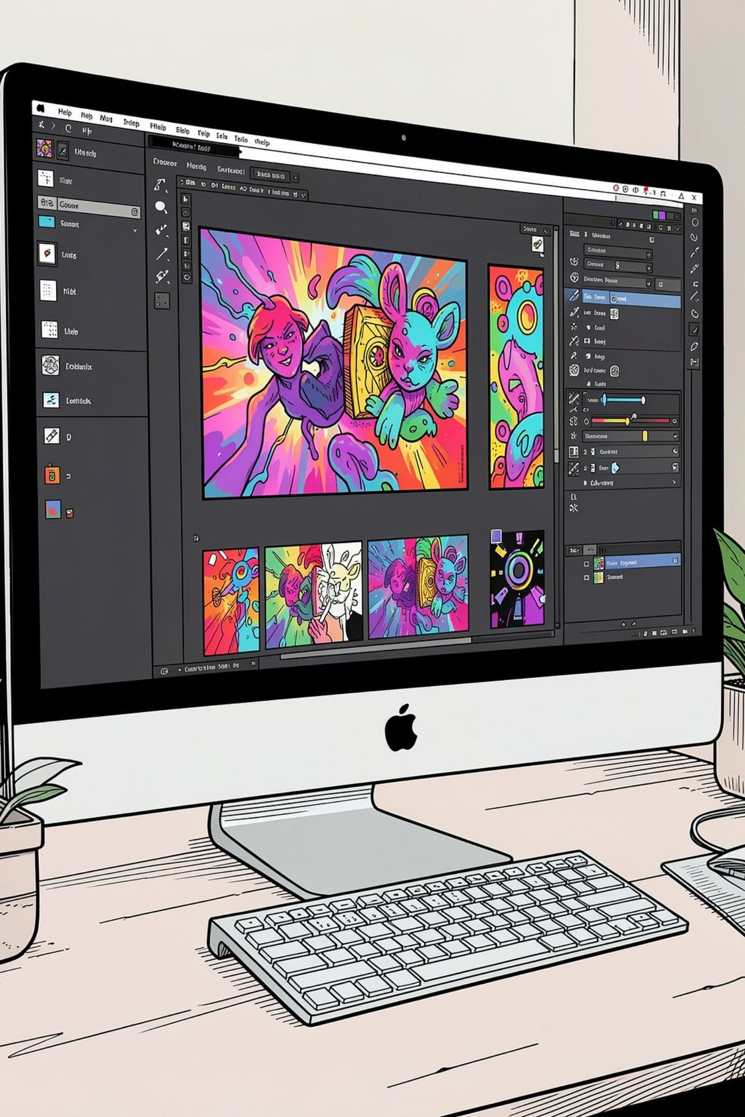
4-AI for image

Slide 7
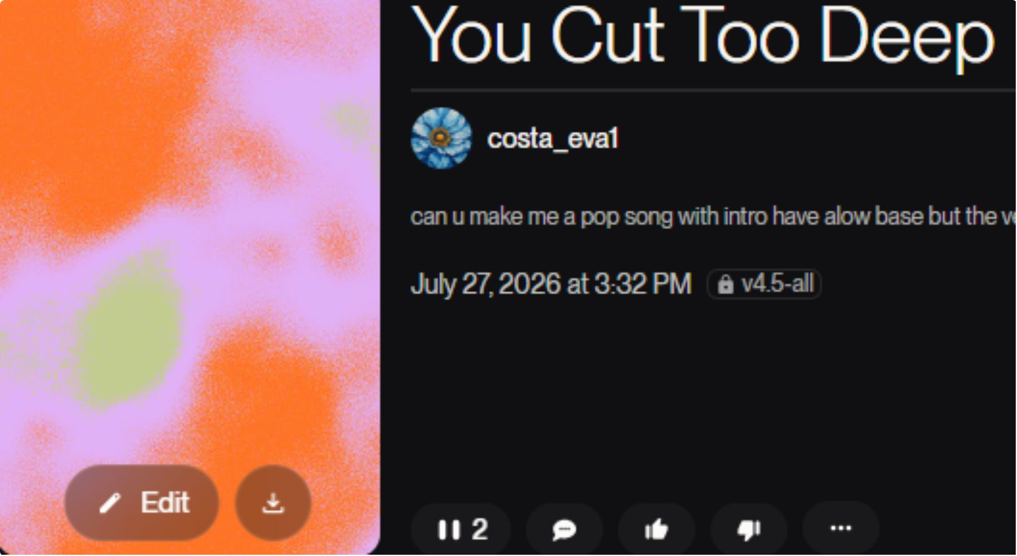
5-Ai for music

Slide 8

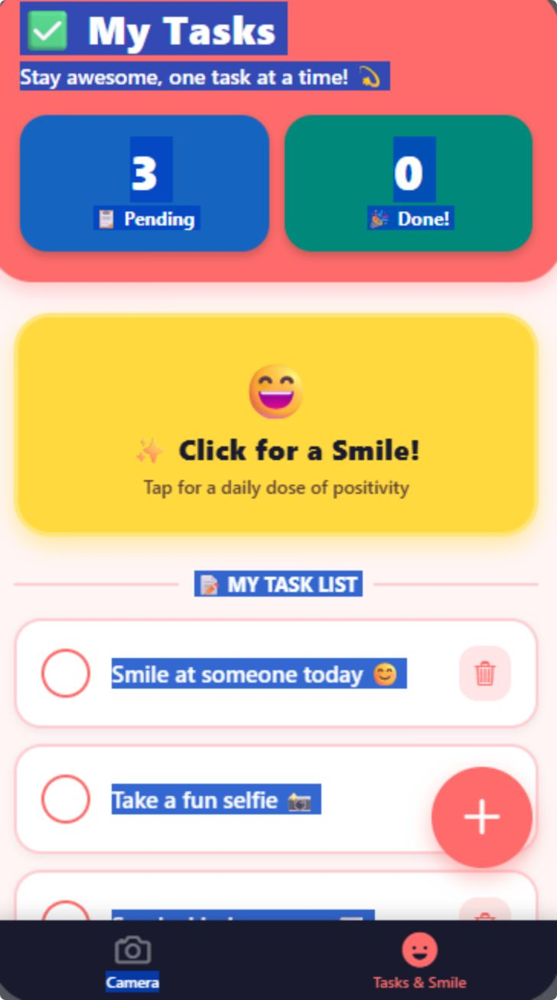
6-Ai for website

Slide 9
7-Ai for website

