Slide 1

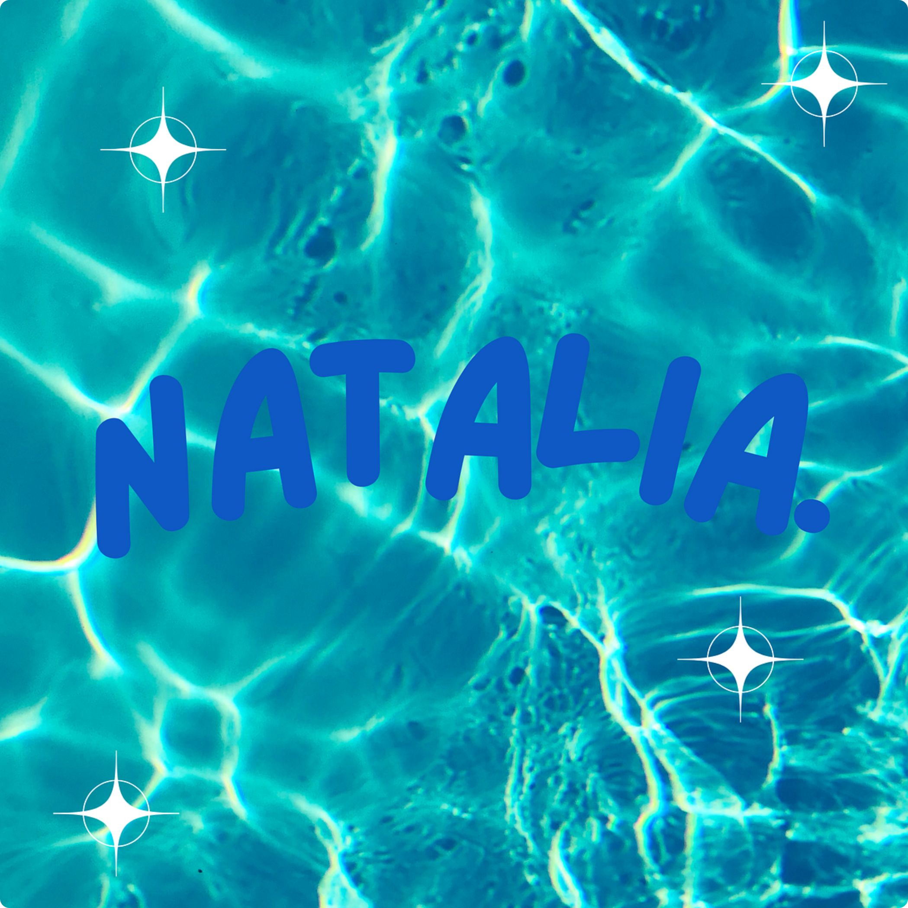
MY PROJECT
NATALIA

Slide 2
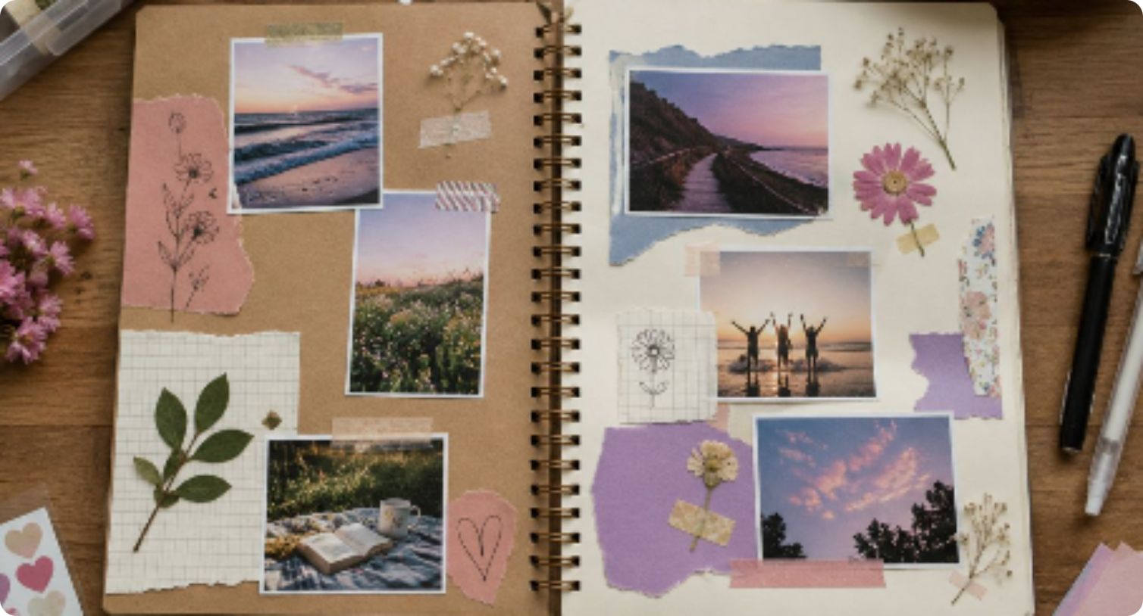
1- Project idea
Fun ideas to do in the summer.Non-screen.

Slide 3
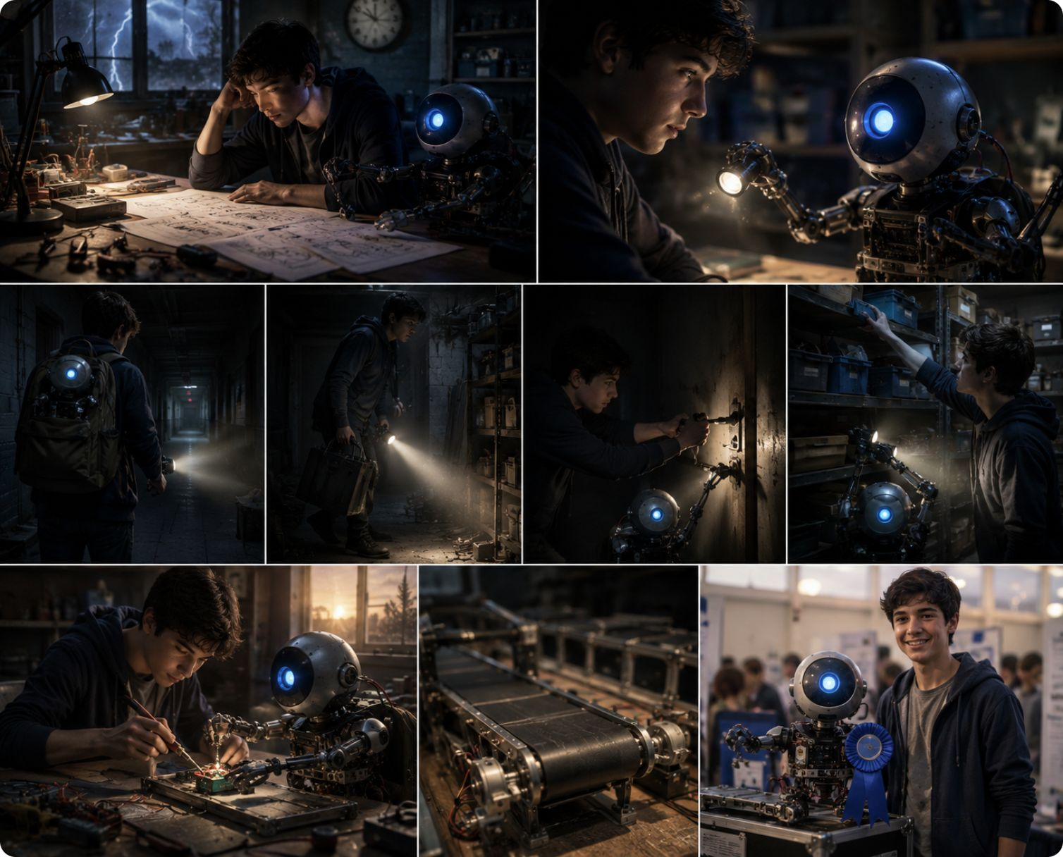
2- AI for writing
You can ask Ai to make a story

Slide 4

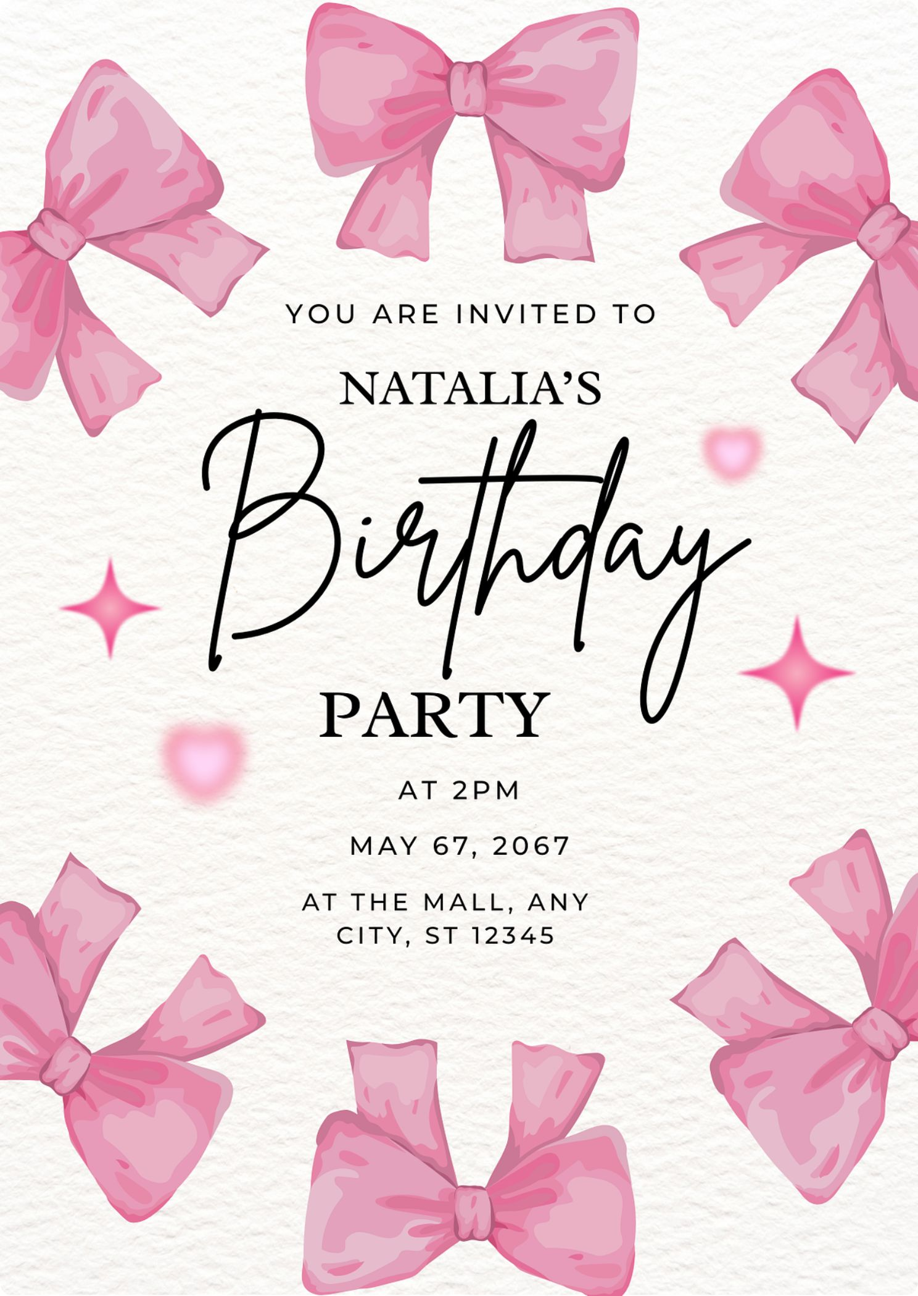
3- AI for graphic design
An invitation to a birthday party and u can design it however you want

Slide 5
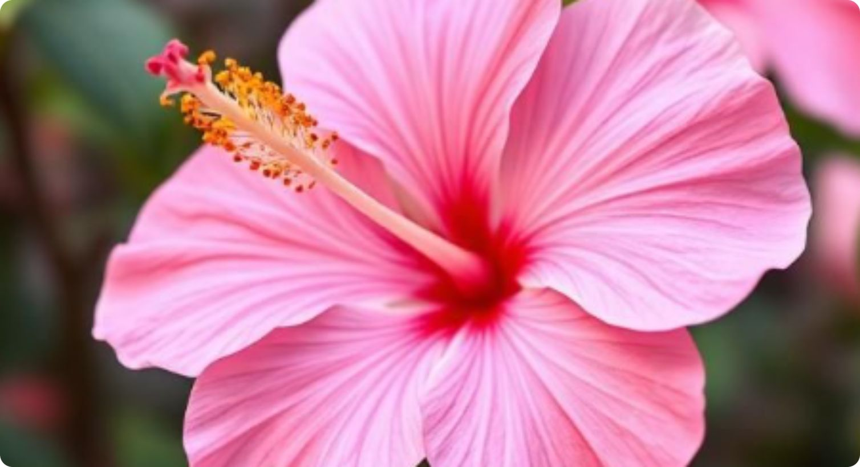
4-Ai for image

Slide 6
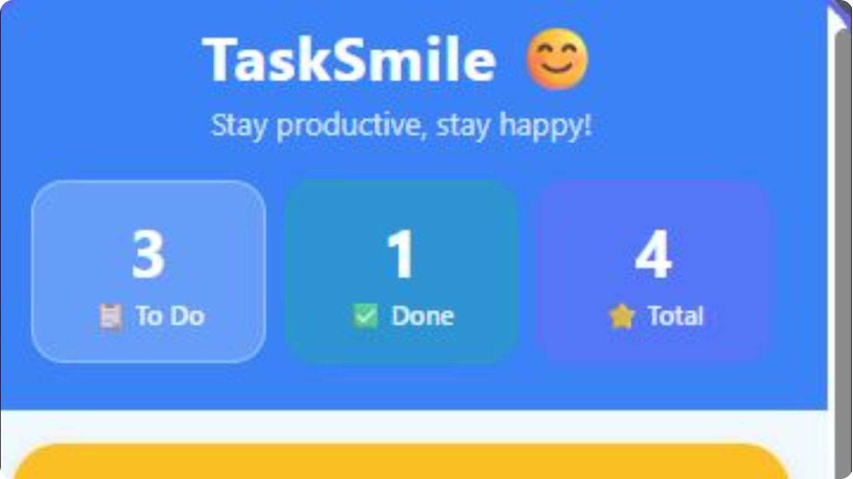
5-Ai for mobile app

Slide 7
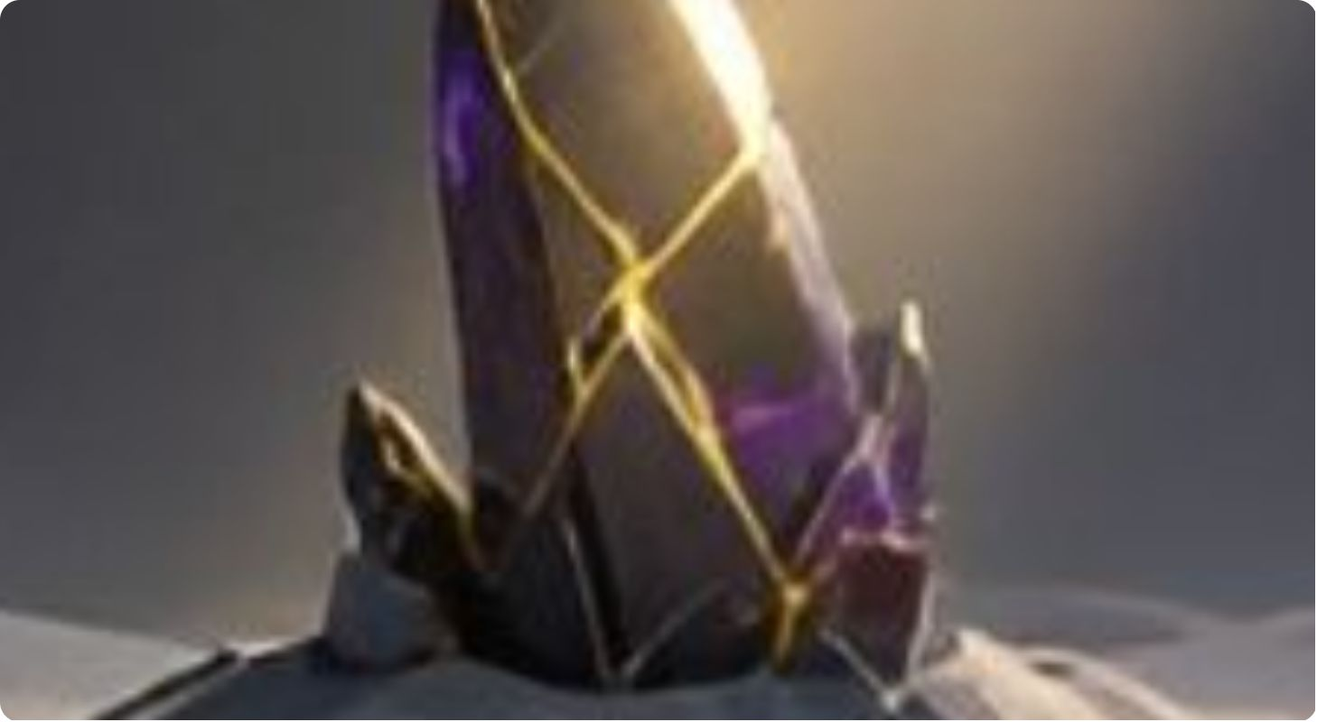
6-Ai for music

Slide 8
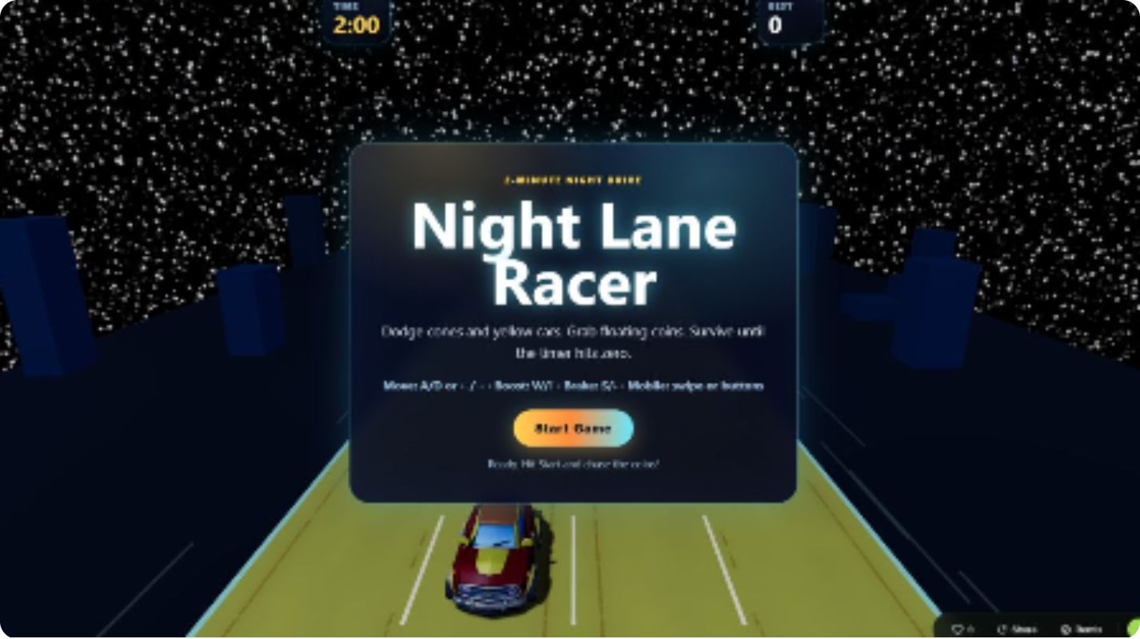
7-Ai for games

Slide 9
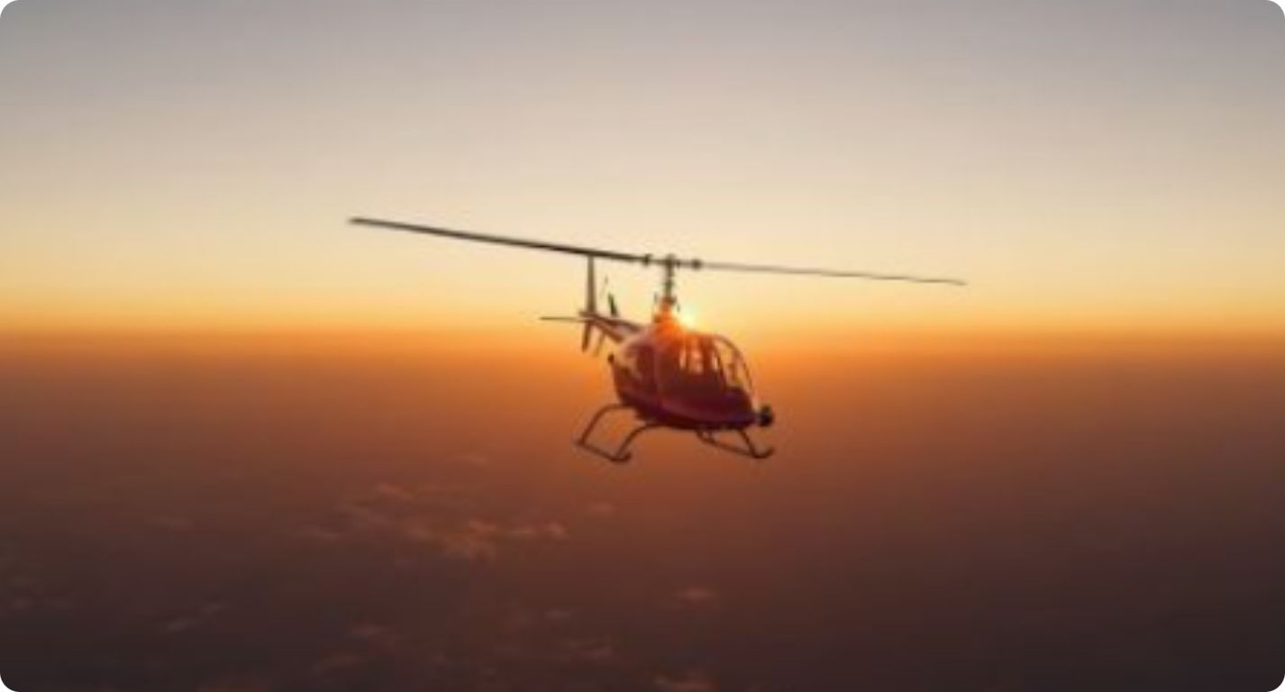
8-Ai for video

Slide 10
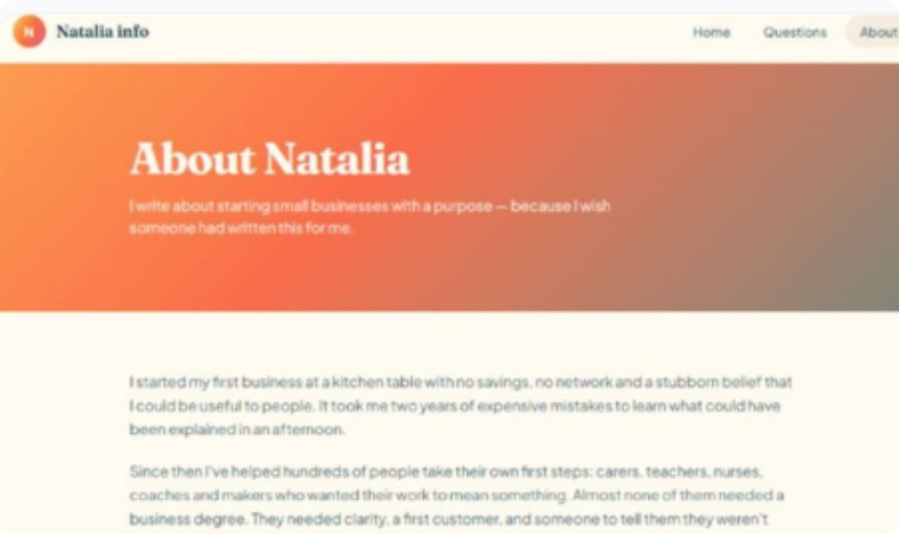
9-Ai for website

