Slide 1


My projects
TANIOS Bou Rouphael

Slide 2
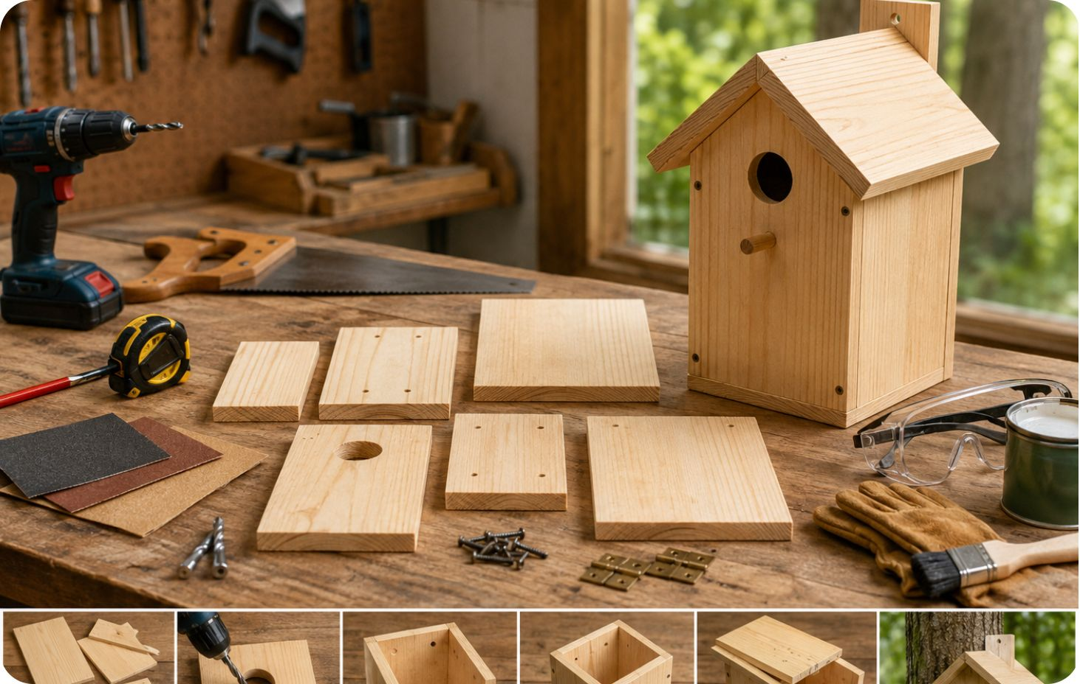
1- project idea
Project: Build a Wooden Birdhouse
This is a beginner-friendly woodworking project that teaches measuring, cutting, drilling, sanding, and finishing.
Goal
Build a weather-resistant birdhouse that can be mounted on a tree or fence.

Slide 3
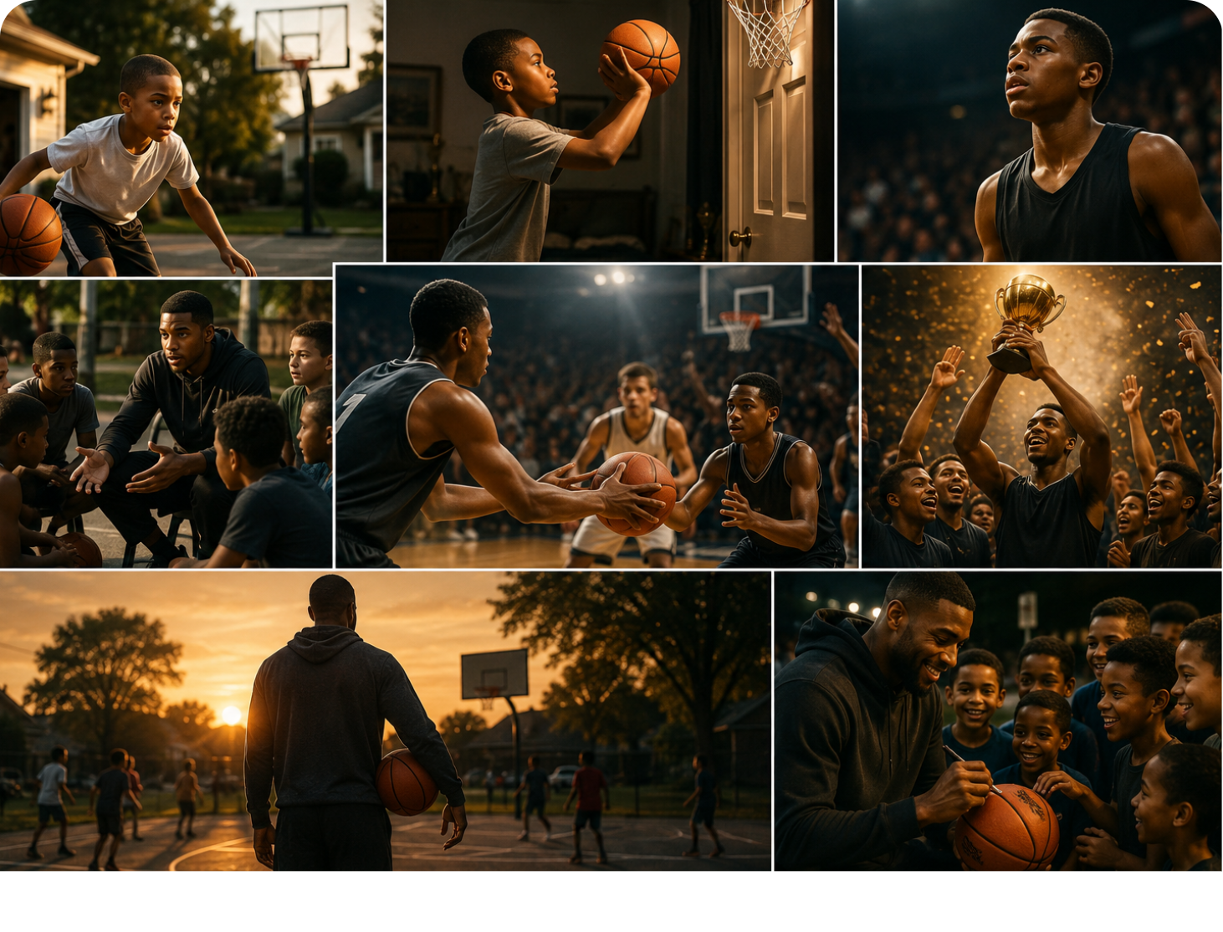
2-Ai For Writing
Summary:
The Legend of Lebron tells the story of a hardworking basketball player
who believes success comes from consistent effort and teamwork. During an important tournament, his team struggles, but Lbron stays positive and encourages everyone to work together. Instead of taking the final shot himself, he passes to a teammate, leading the team to victory. Afterward, Lbron says that hard work, helping others, and never giving up are more important than winning, inspiring people both on and off the court.

Slide 4
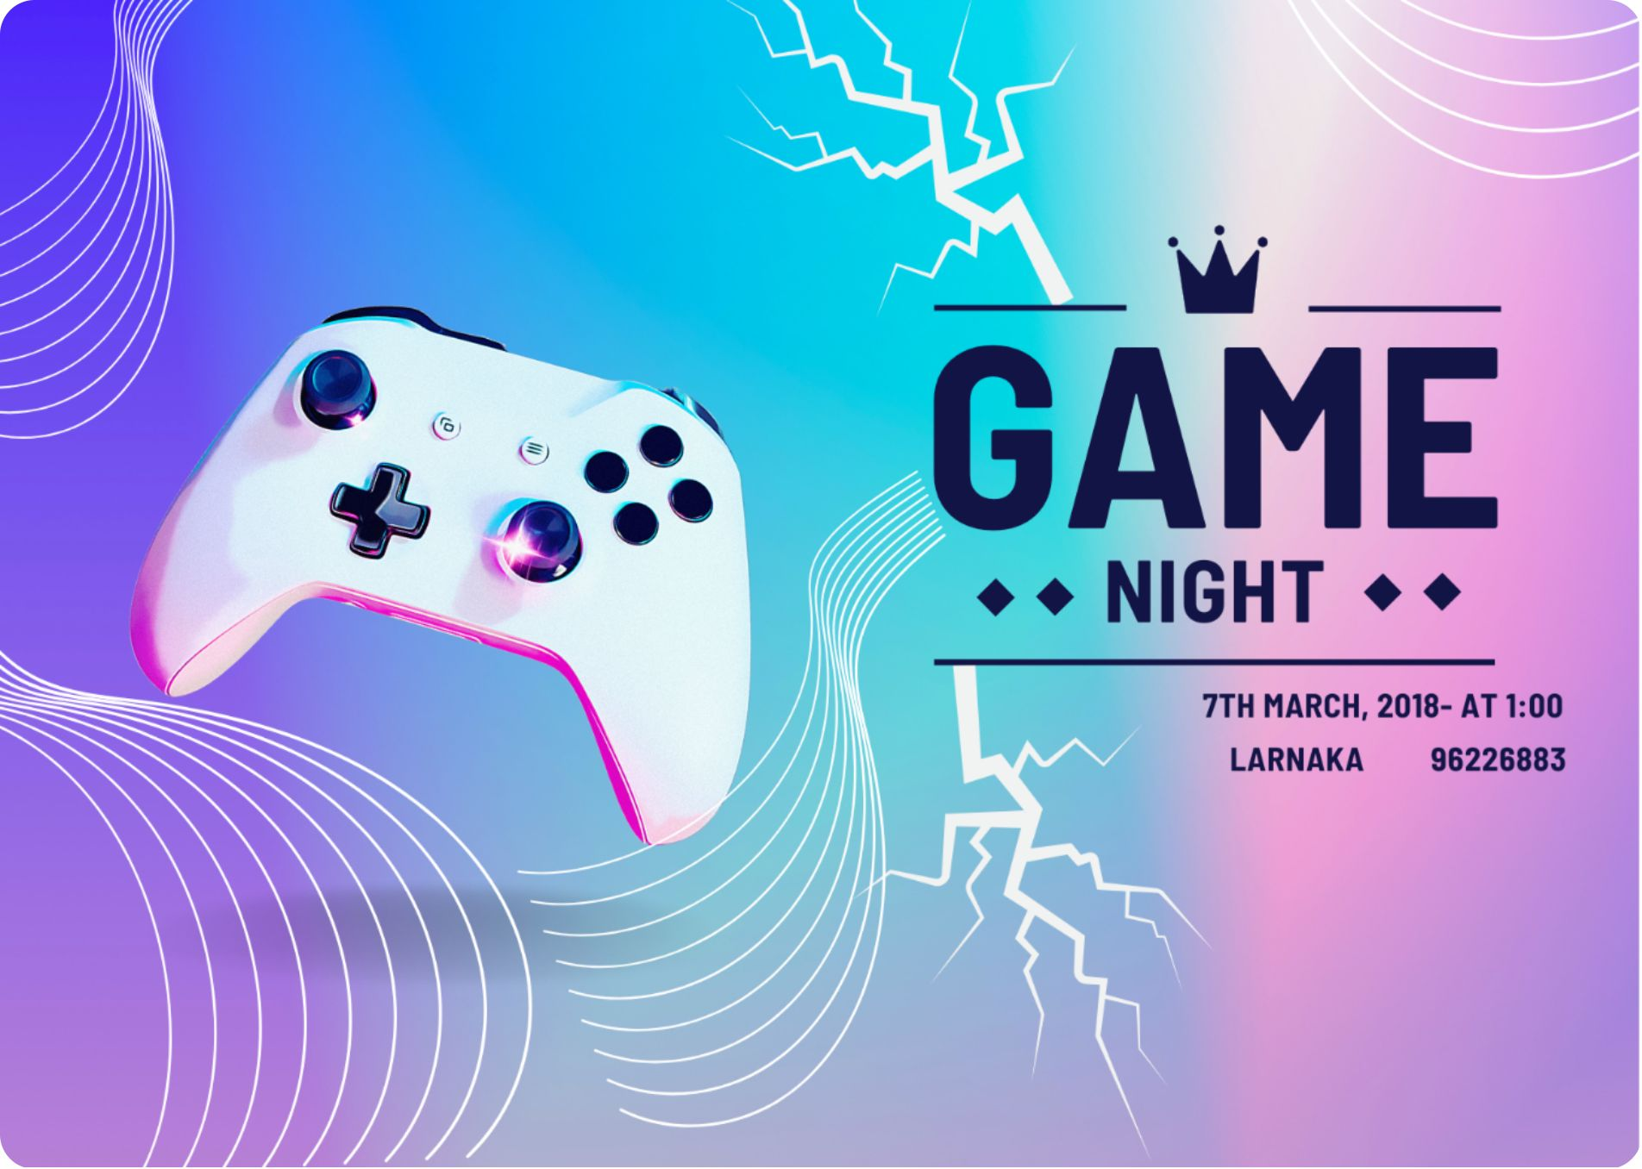
3- AI for Graphic Design
Game night for boys

Slide 5


4- AI for Image
This is a wide scene image about nature square format, depth, smooth, stripes, warm, geometric, wide scene

Slide 6
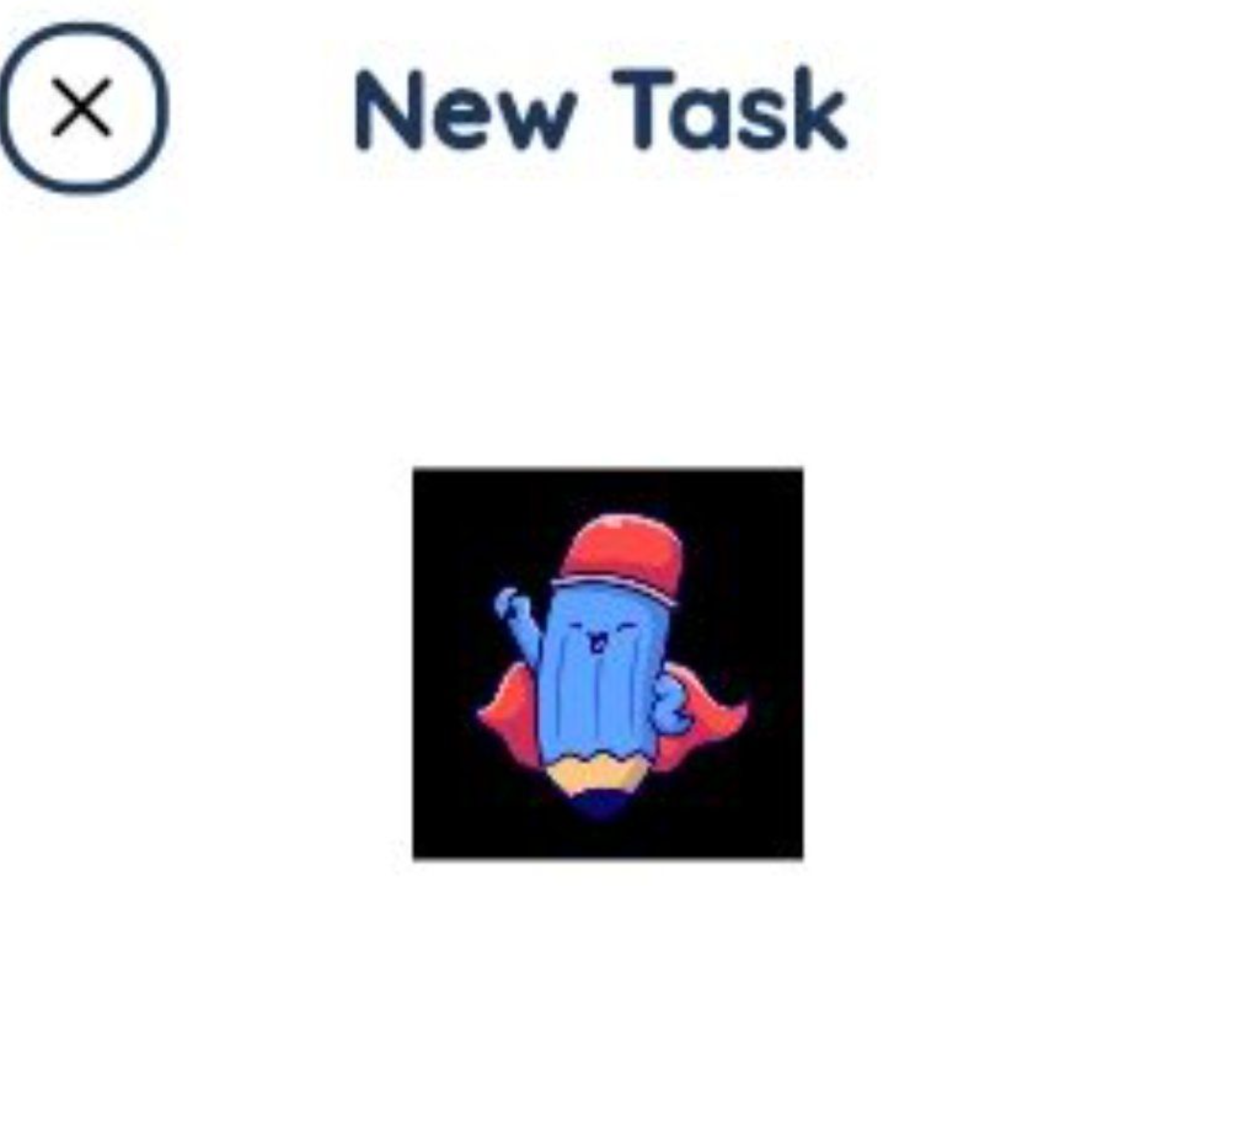
5- AI for Mobile App
this is where i put my tasks in a list.

Slide 7

6- AI for Music
This is a song about rap and rock

Slide 8
7- AI for Video
This is a video

Slide 9
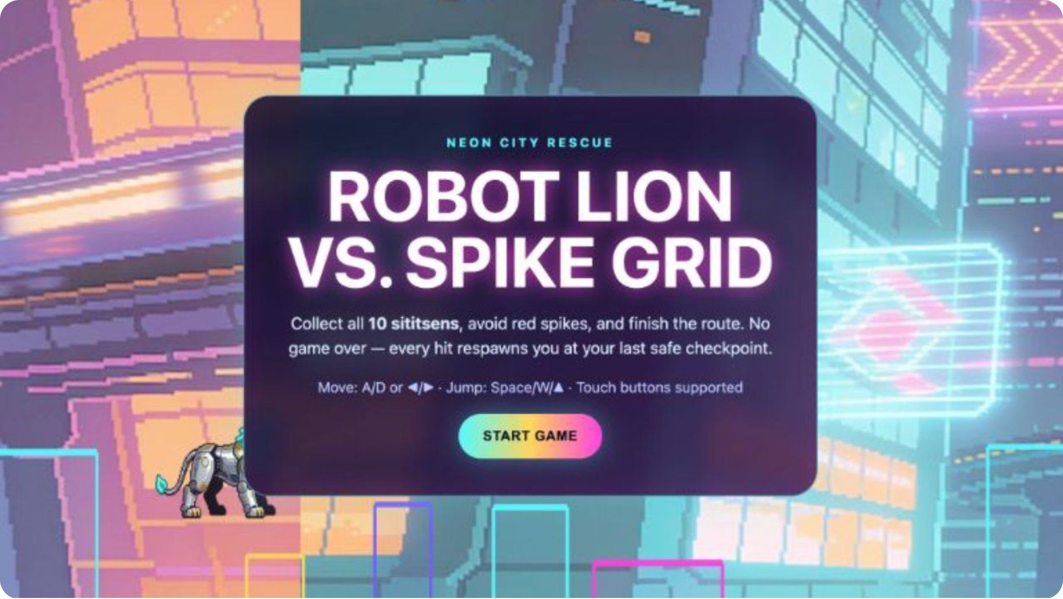
8- AI for Game
This is a platformer game about a lion parkour
[press link to play]
(https://www.seeles.ai/play/42754bce-57f2-43ec-bcdd-40a30f513703)

Slide 10
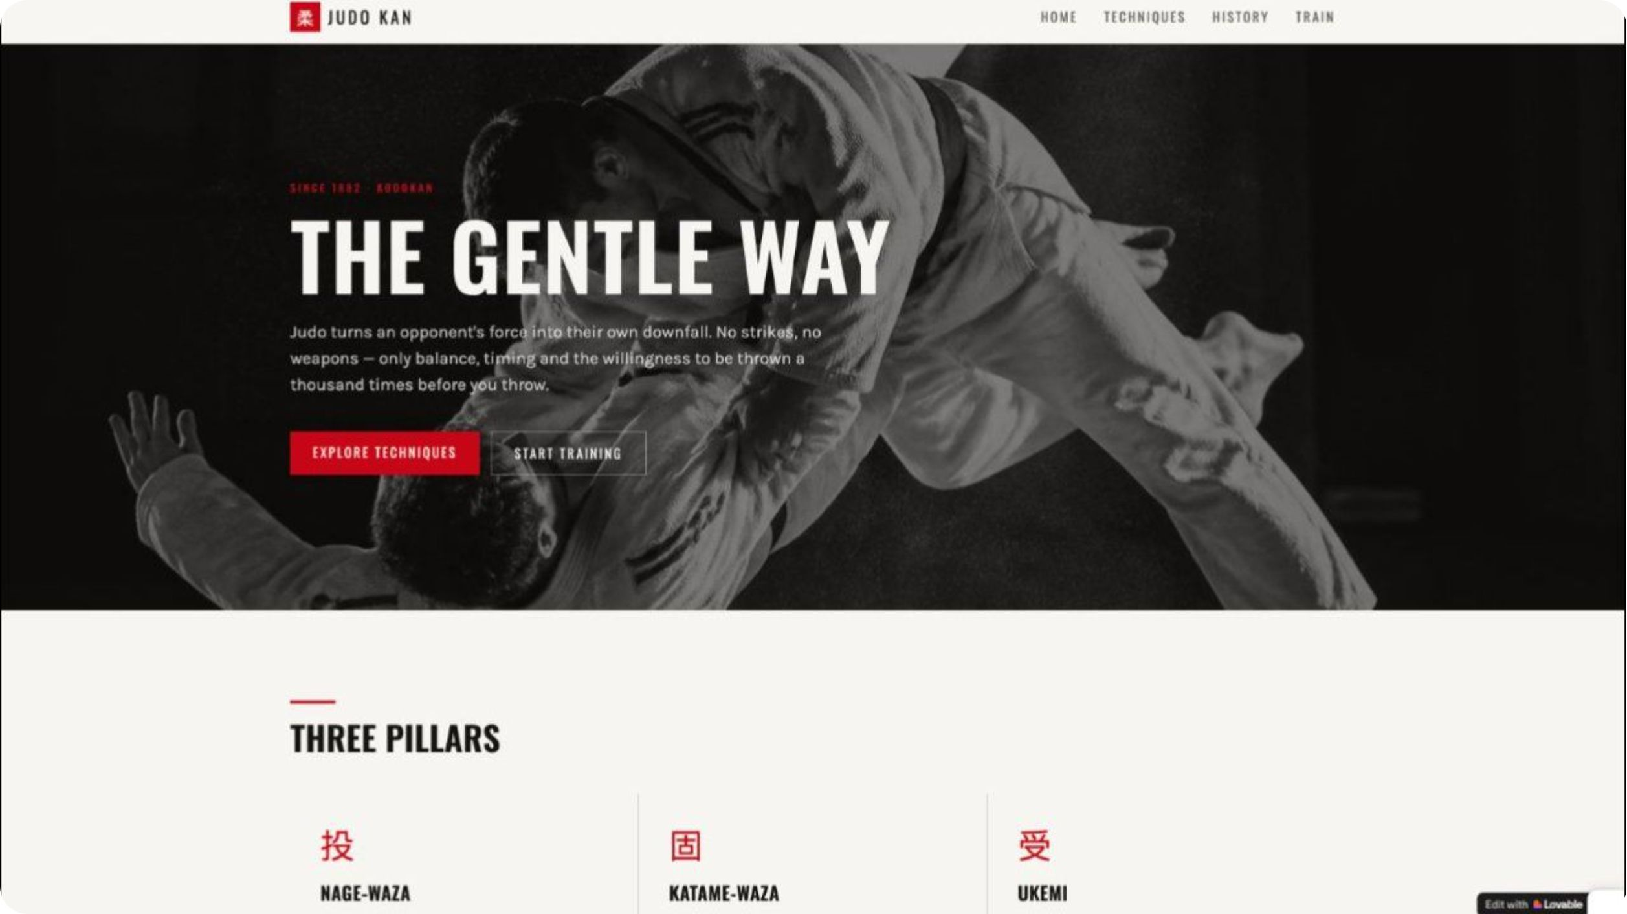
9- AI for Website
This is a website

