Slide 1

MY project

Slide 2
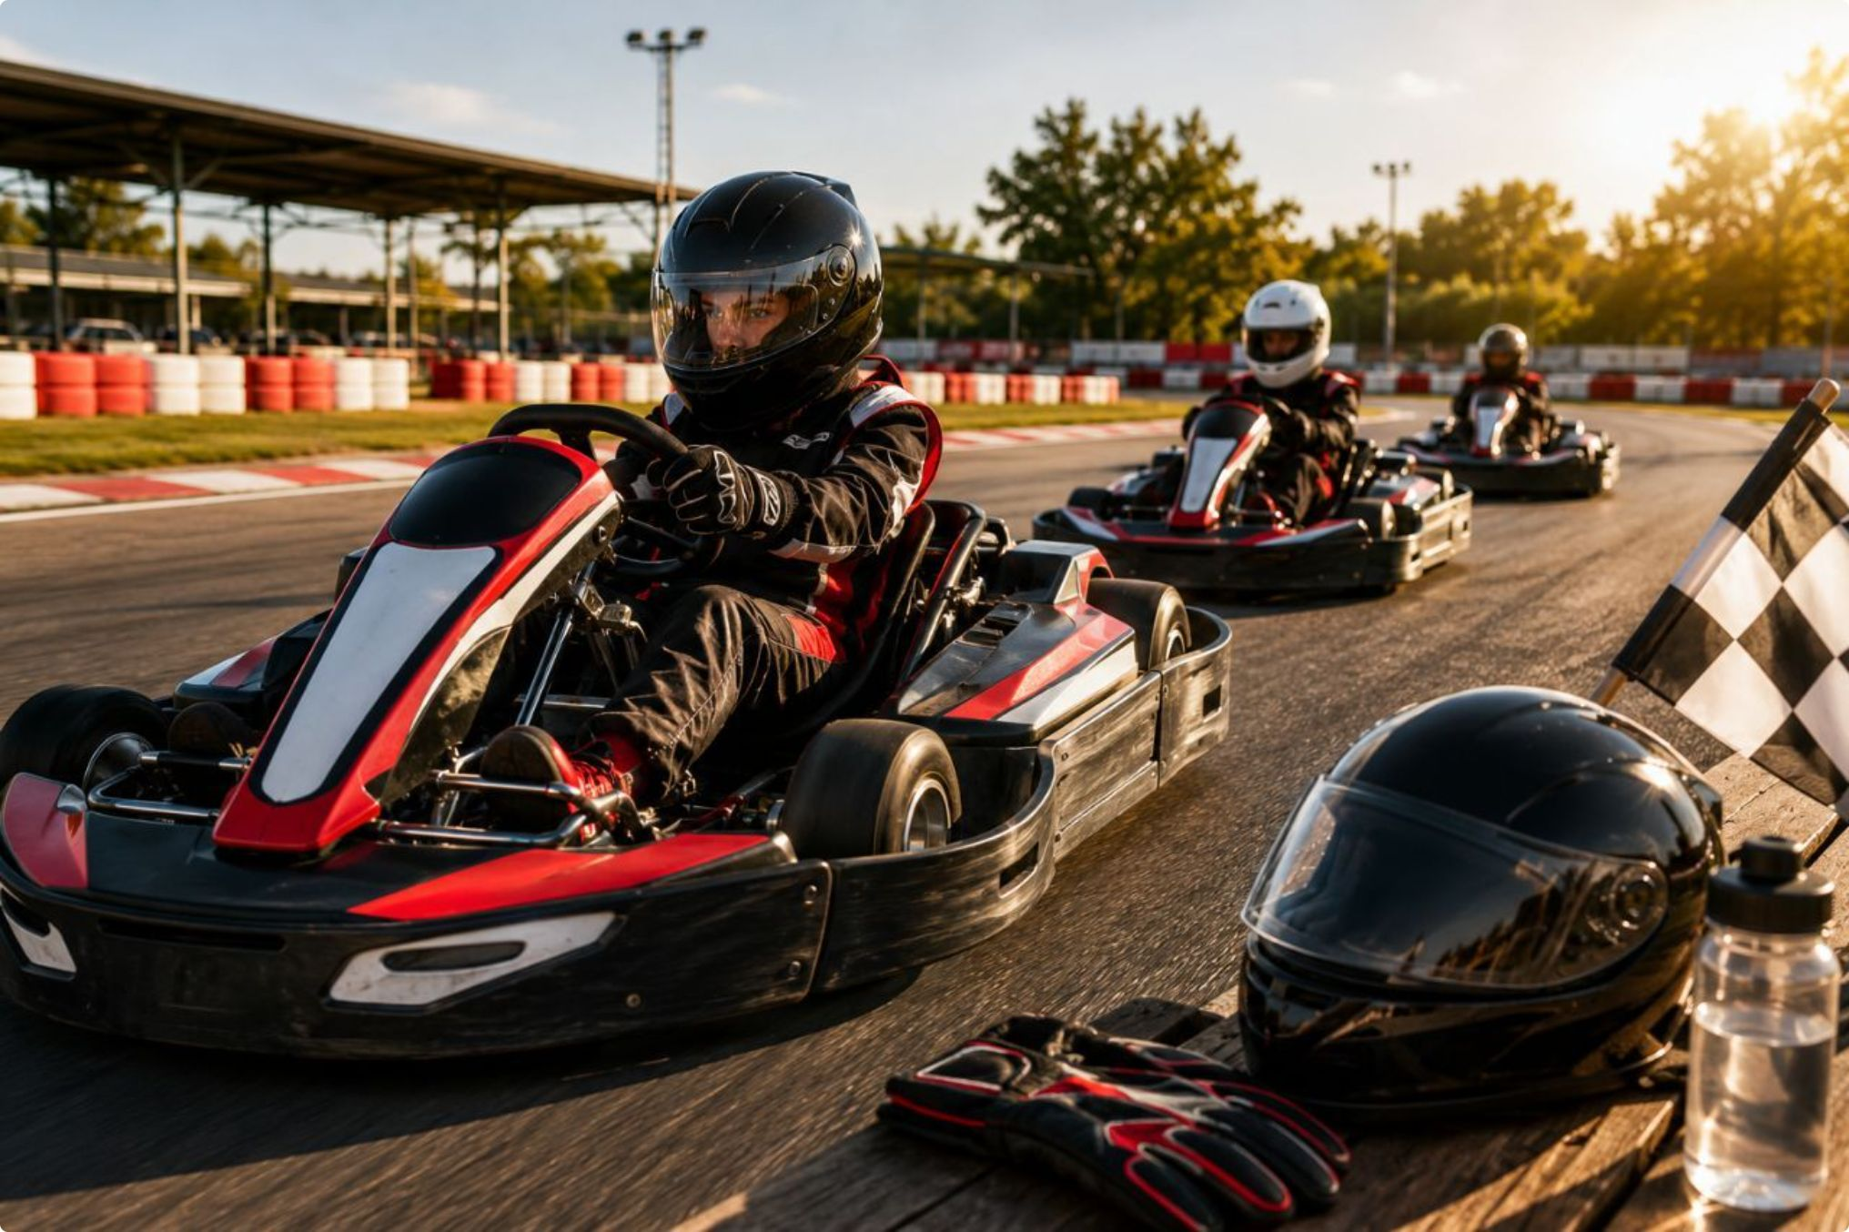

1- Project idea
Race friends or family
My project helps people have fun

Slide 3
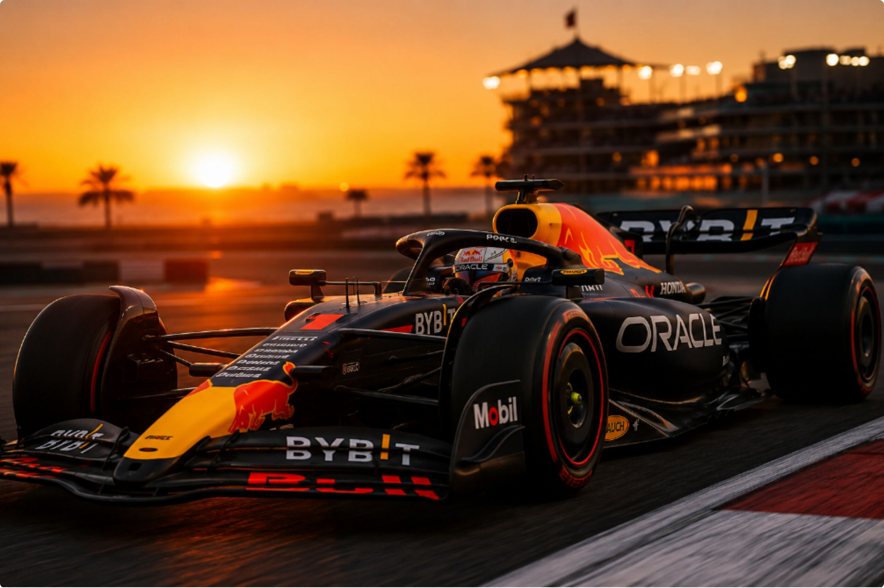
2- AI for writing
A story:
My project helps people ……

Slide 4
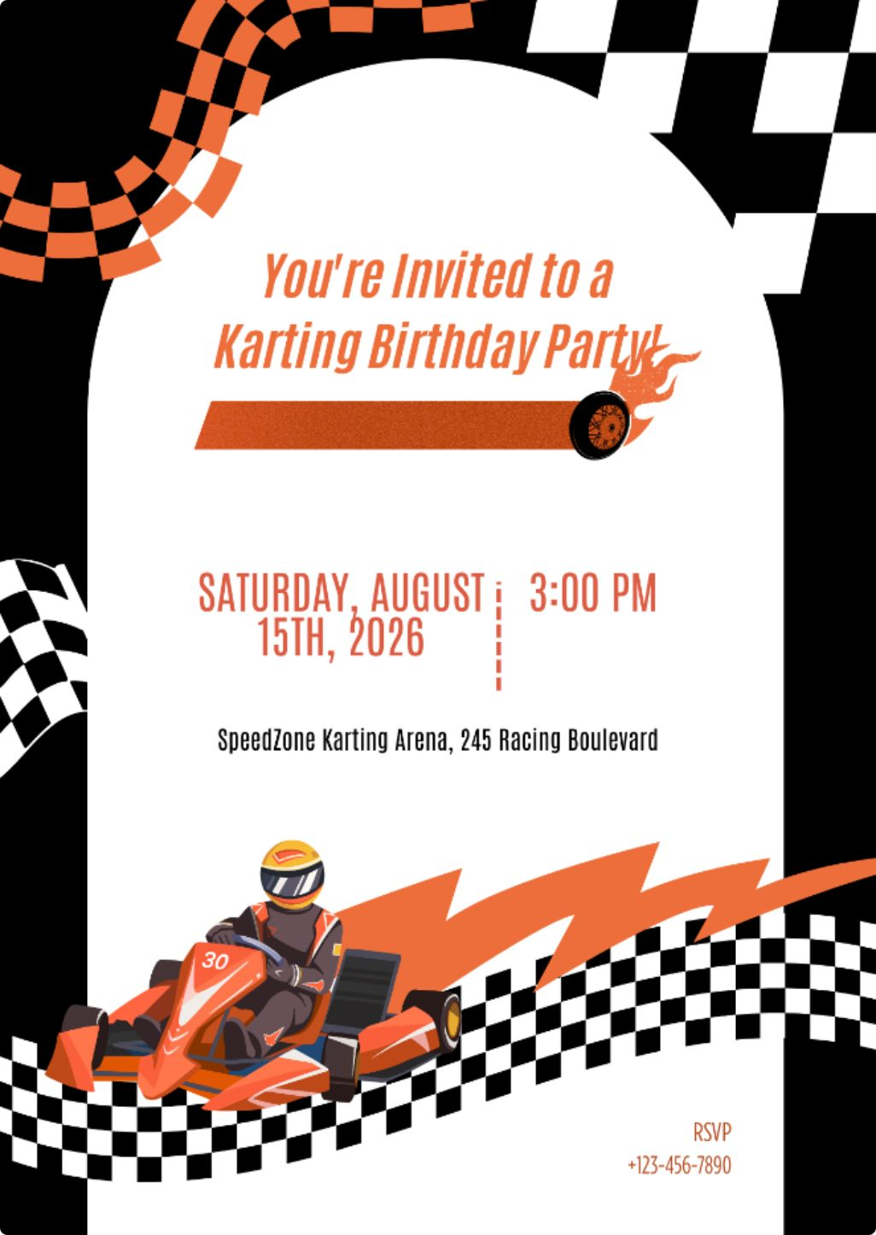


3- AI for graphic Design

Slide 5
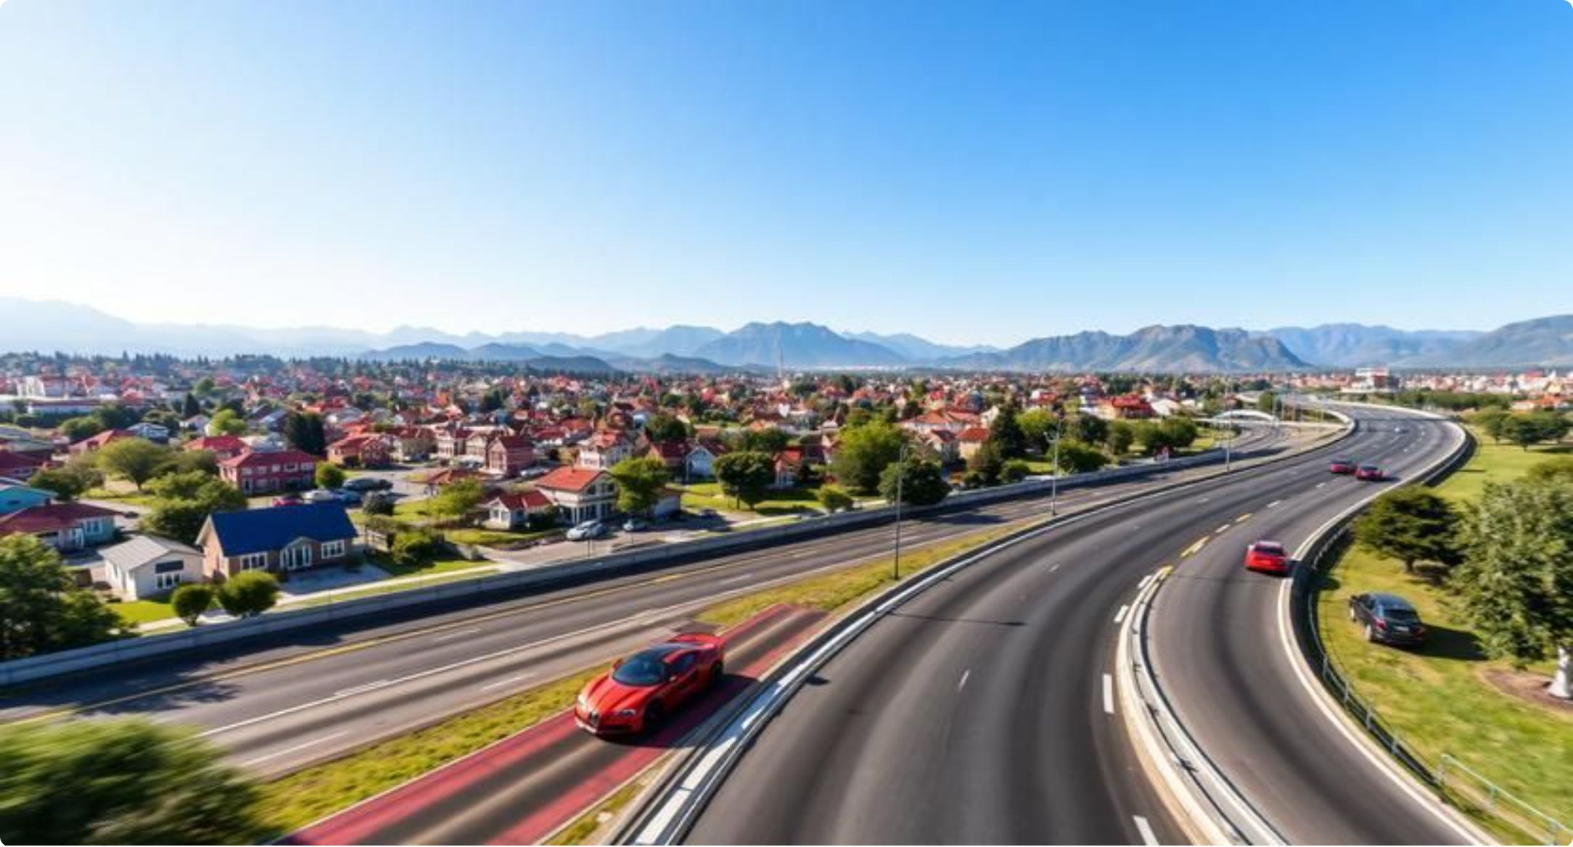
4- AI for image

Slide 6
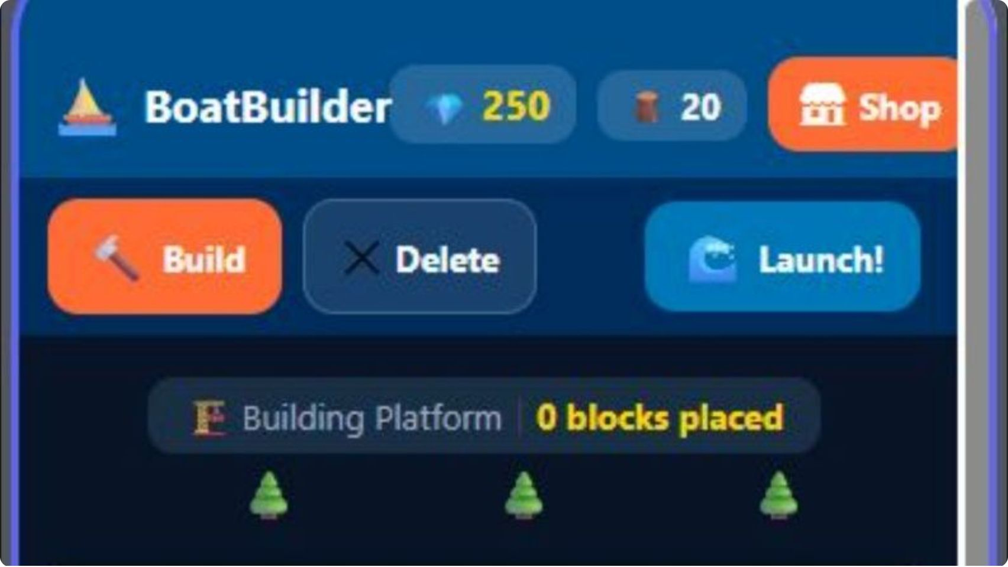
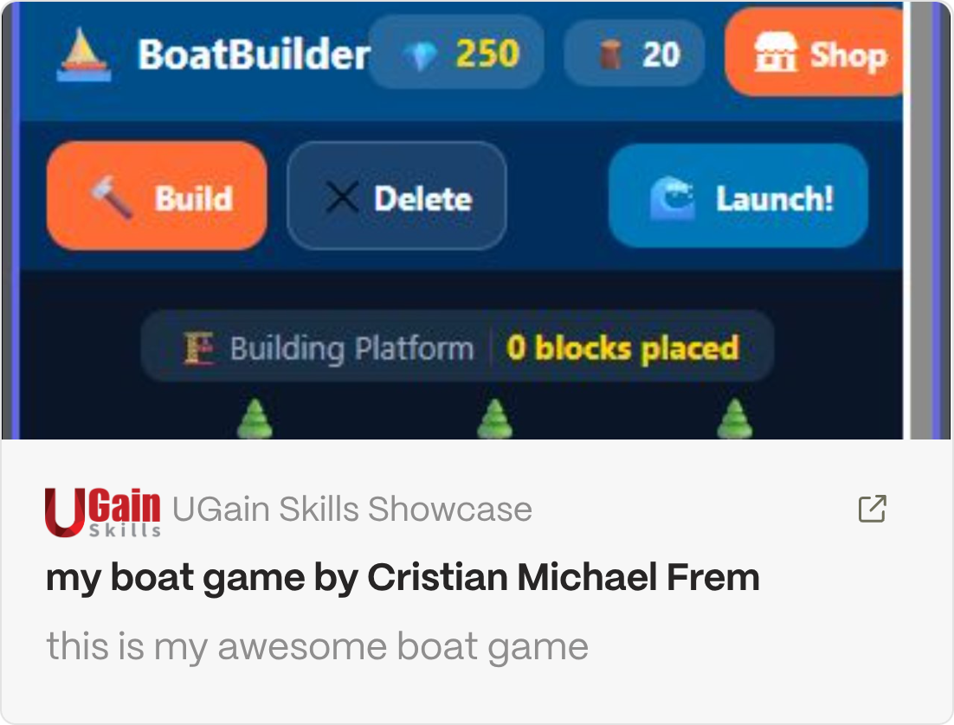
5- AI for Mobile App

Slide 7

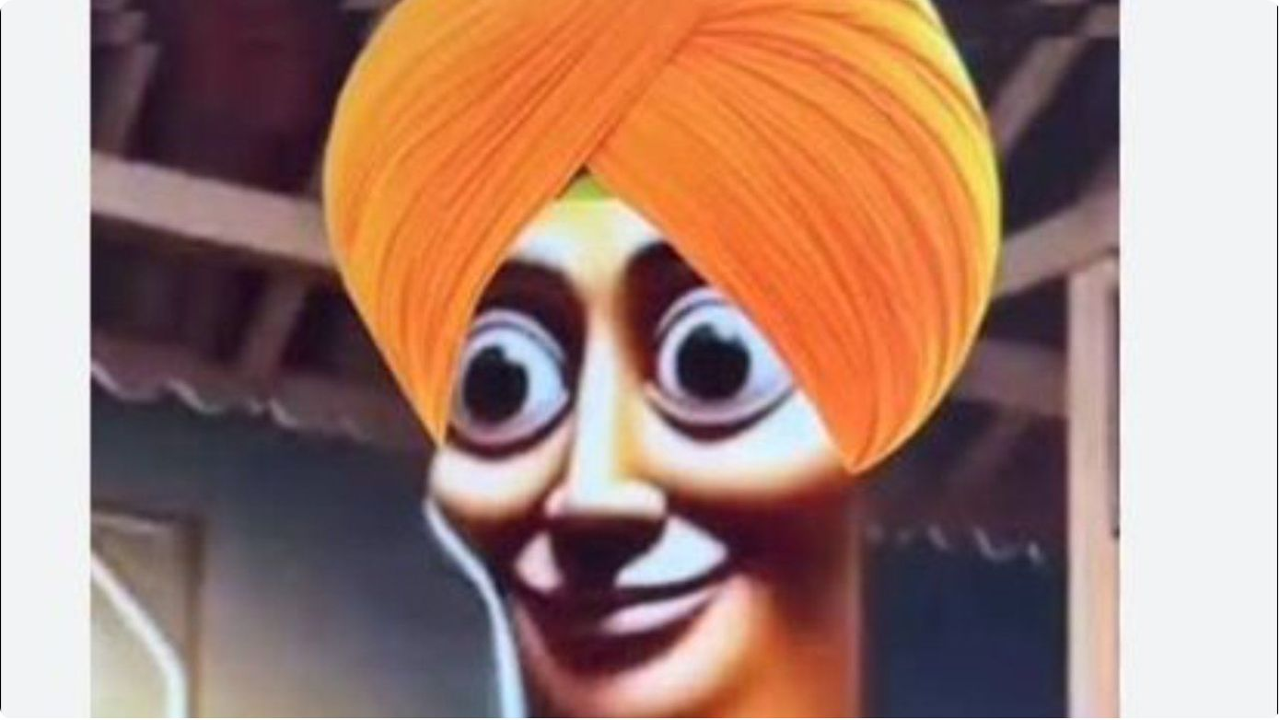

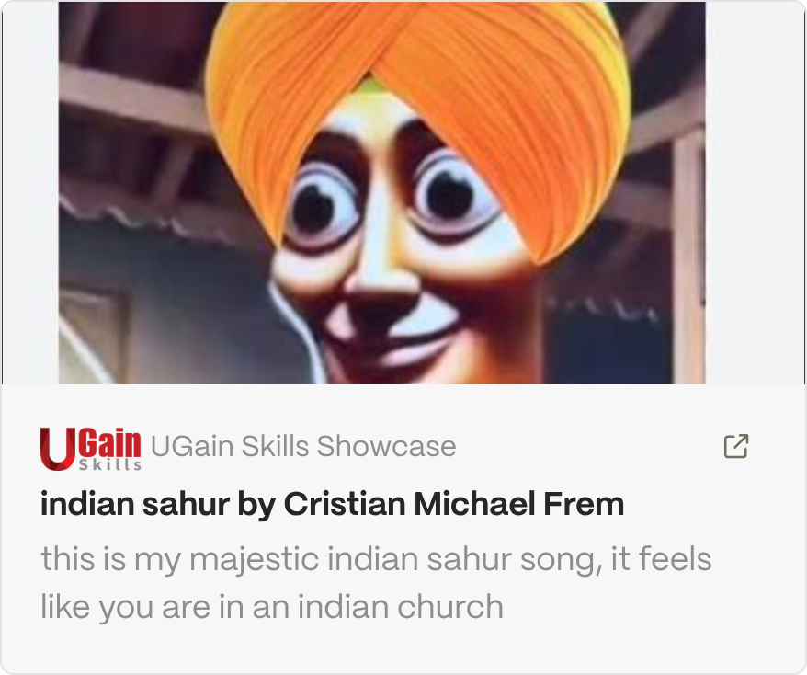
6- AI for music

Slide 8

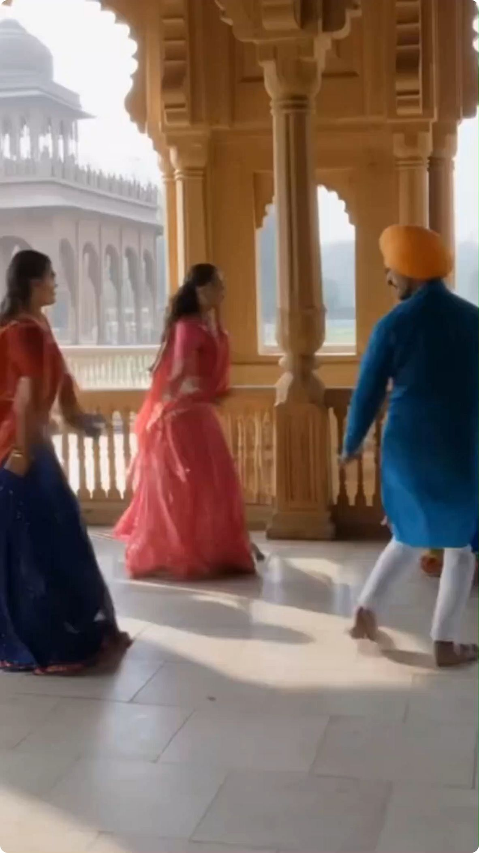
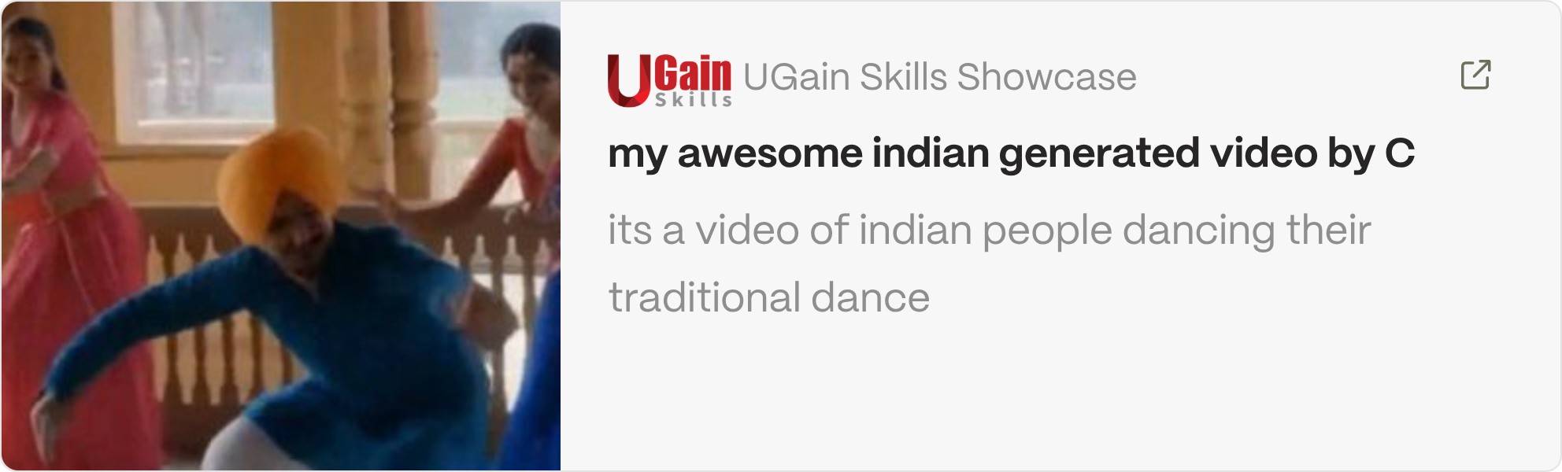
7- AI for Video

Slide 9
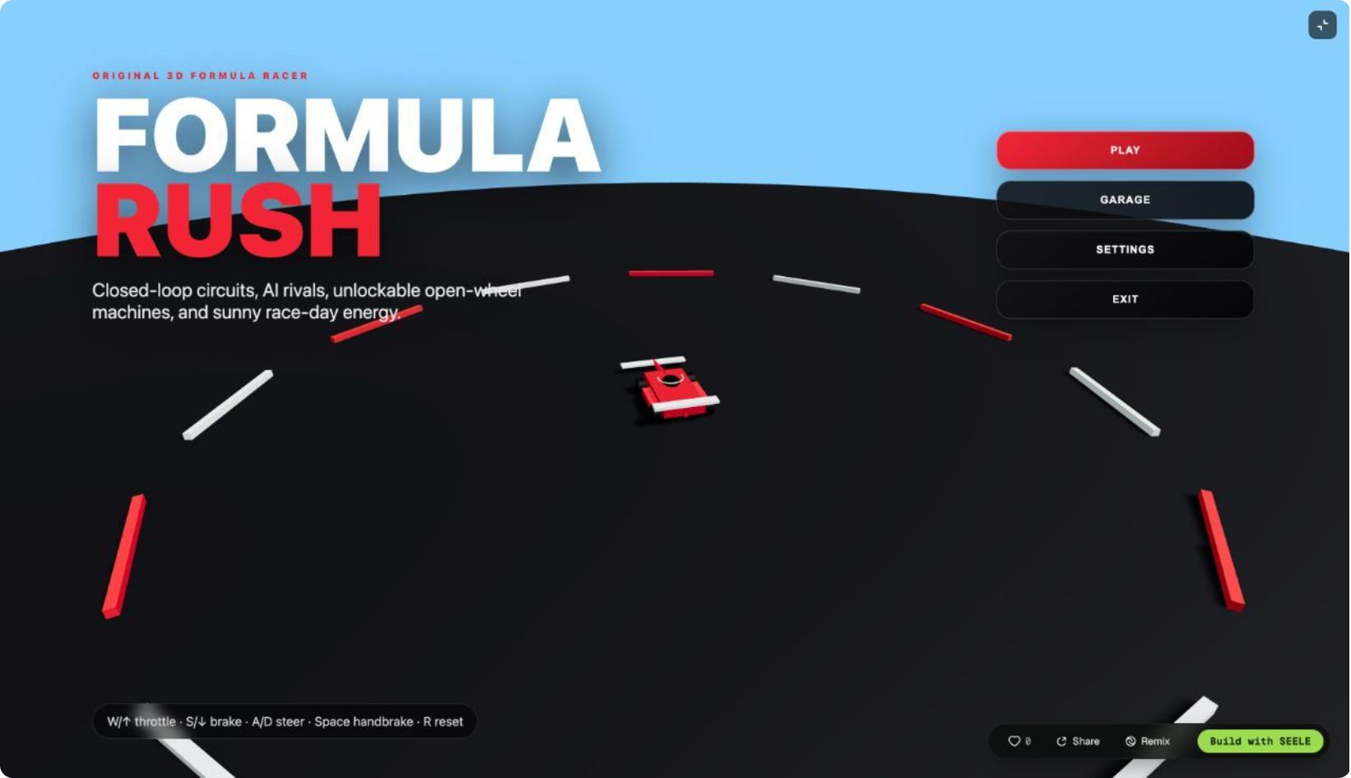
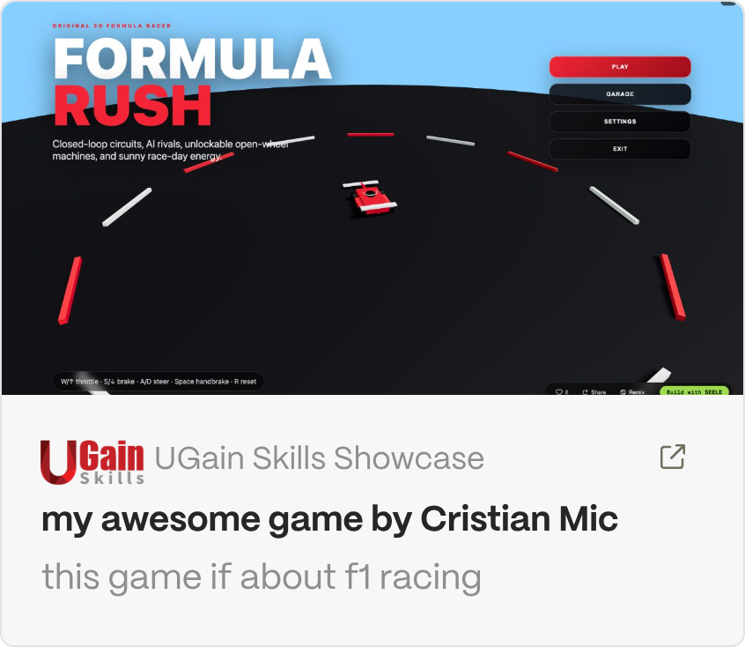
8- AI for Games
https://competitions.ugainskills.com/functions/shareProject?id=6a69ff7977c4aede342ff97b&from=https%3A%2F%2Fcompetitions.ugainskills.com

Slide 10
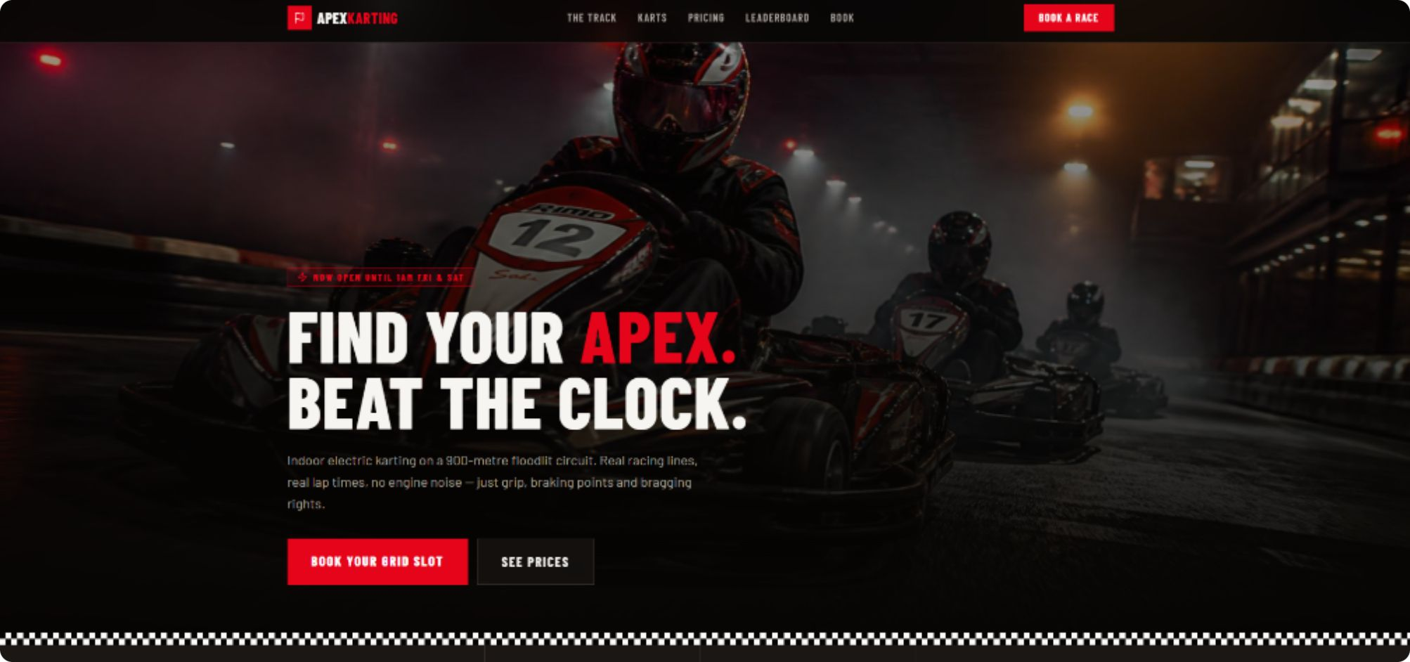


9- AI for website

