Slide 1


MY PROJECTS
BOGDAN

Slide 2
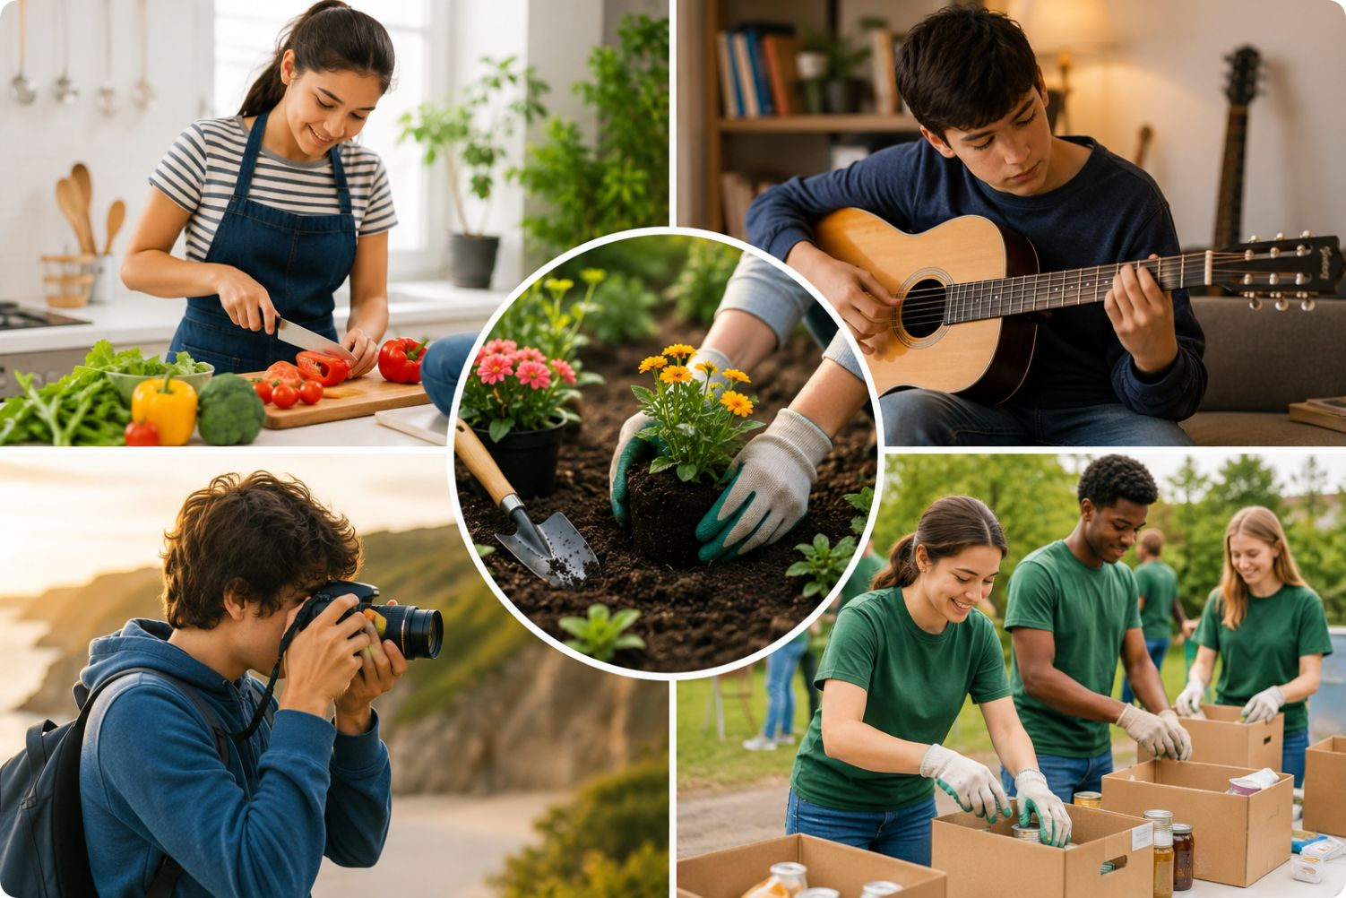
1- Project Idea. Learn a new skill
Learn how to cook healthy meals, bake delicious treats, play a musical instrument, grow flowers or vegetables in a garden, or practice photography with a camera.
My project helps people to improve

Slide 3
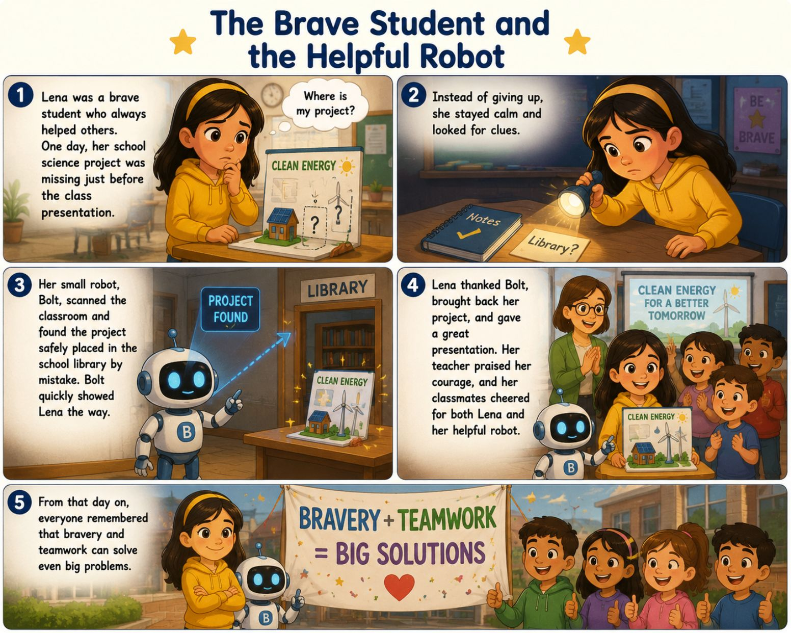
2- AI for Writing A story
The Brave Student and the Helpful Robot
Lena was a brave student who always helped others. One day, her school science project was missing just before the class presentation. Instead of giving up, she stayed calm and looked for clues.
Her small robot, Bolt, scanned the classroom and found the project safely placed in the school library by mistake. Bolt quickly showed Lena the way.
Lena thanked Bolt, brought back her project, and gave a great presentation. Her teacher praised her courage, and her classmates cheered for both Lena and her helpful robot.
From that day on, everyone remembered that bravery and teamwork can solve even big problems.
My project helps people about teamwork

Slide 4

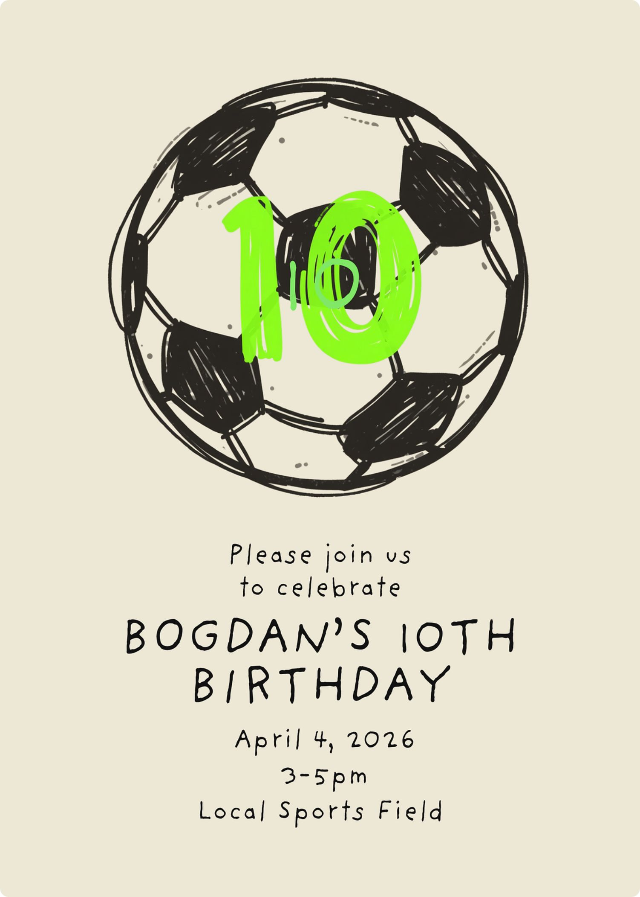
3- AI for Graphic Design An invitation card
My birthday
I'm inviting my friends to gather and celebrate my birthday
My project helps people to gather

Slide 5

4- AI for Image Future phone
My project helps people to gather

Slide 6

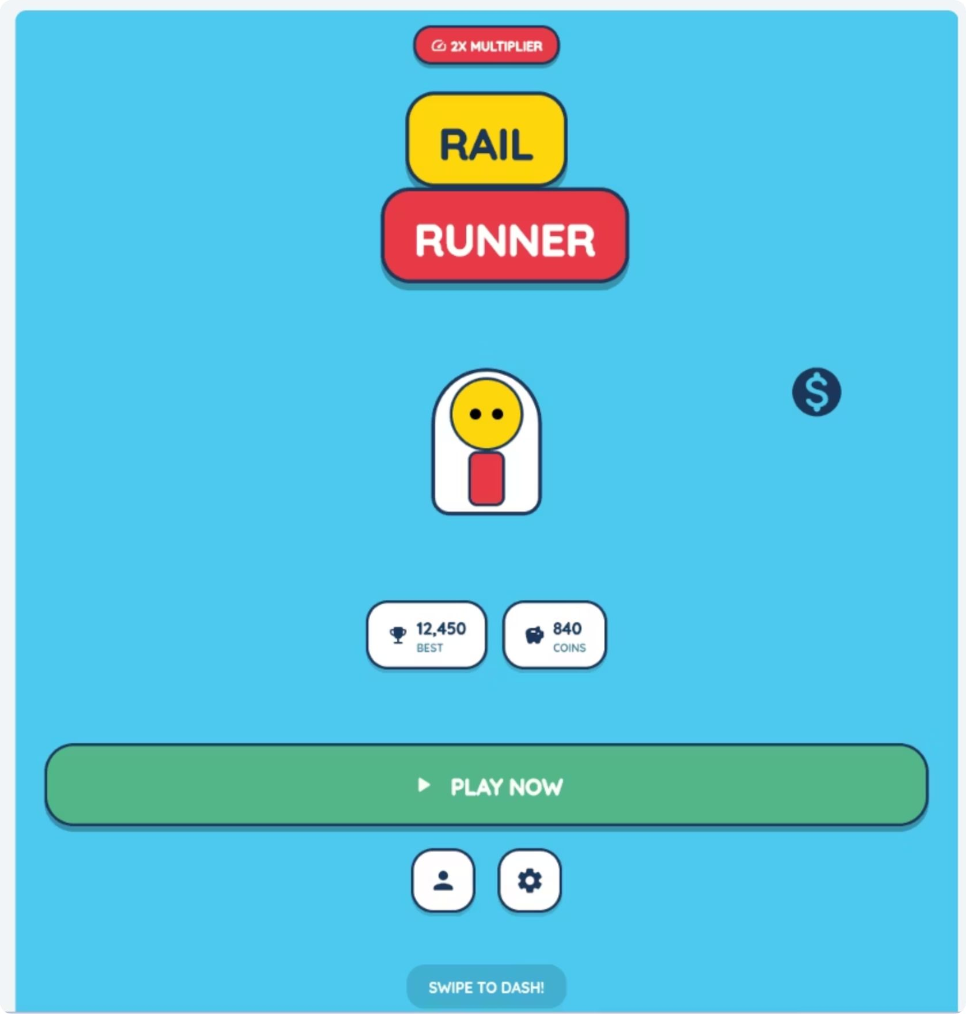
5- AI for Mobile App
https://bogdan-s.netlify.app/

Slide 7

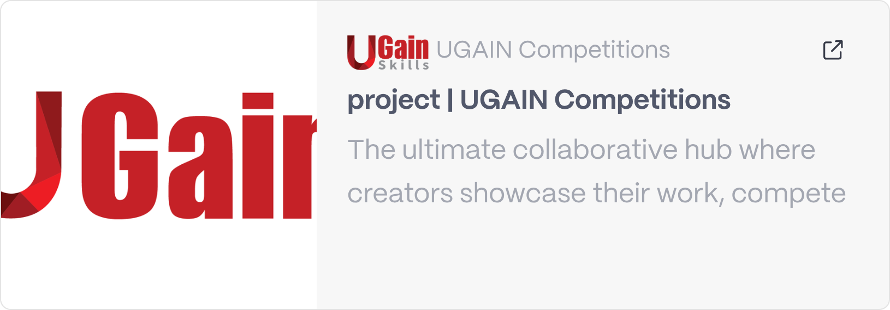
6- AI for Music

Slide 8
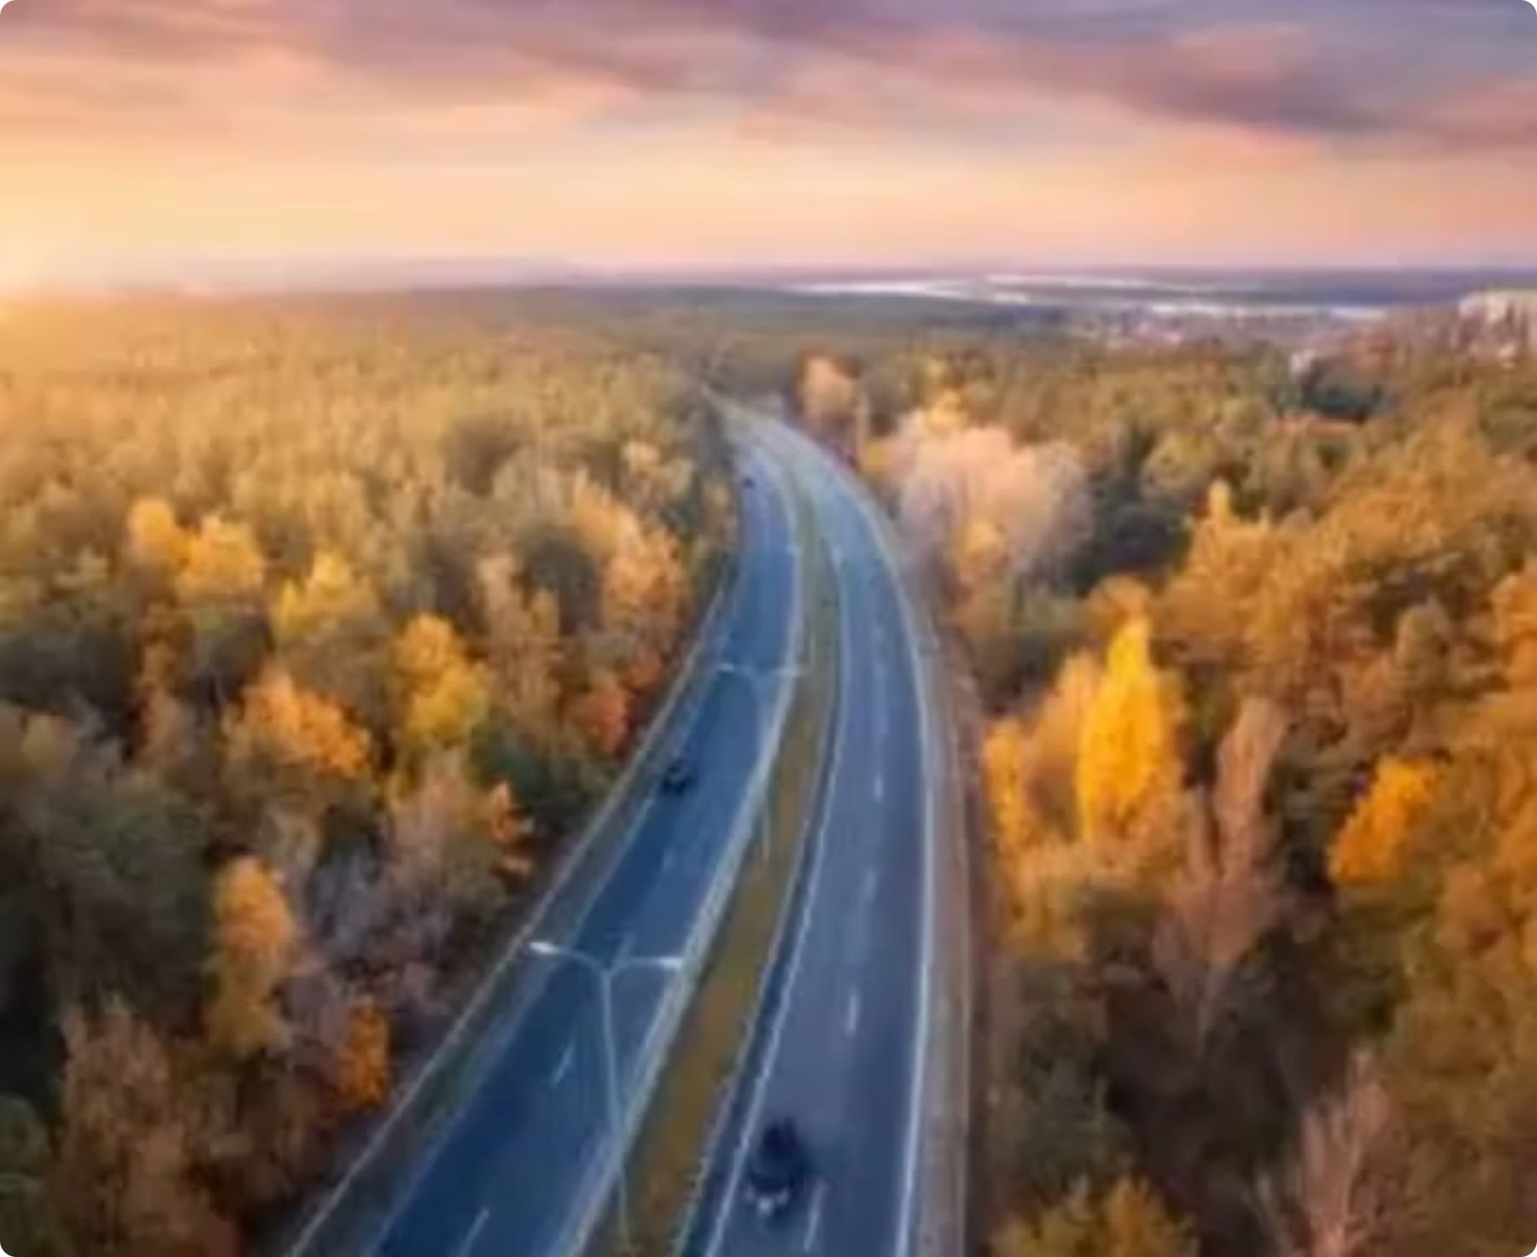
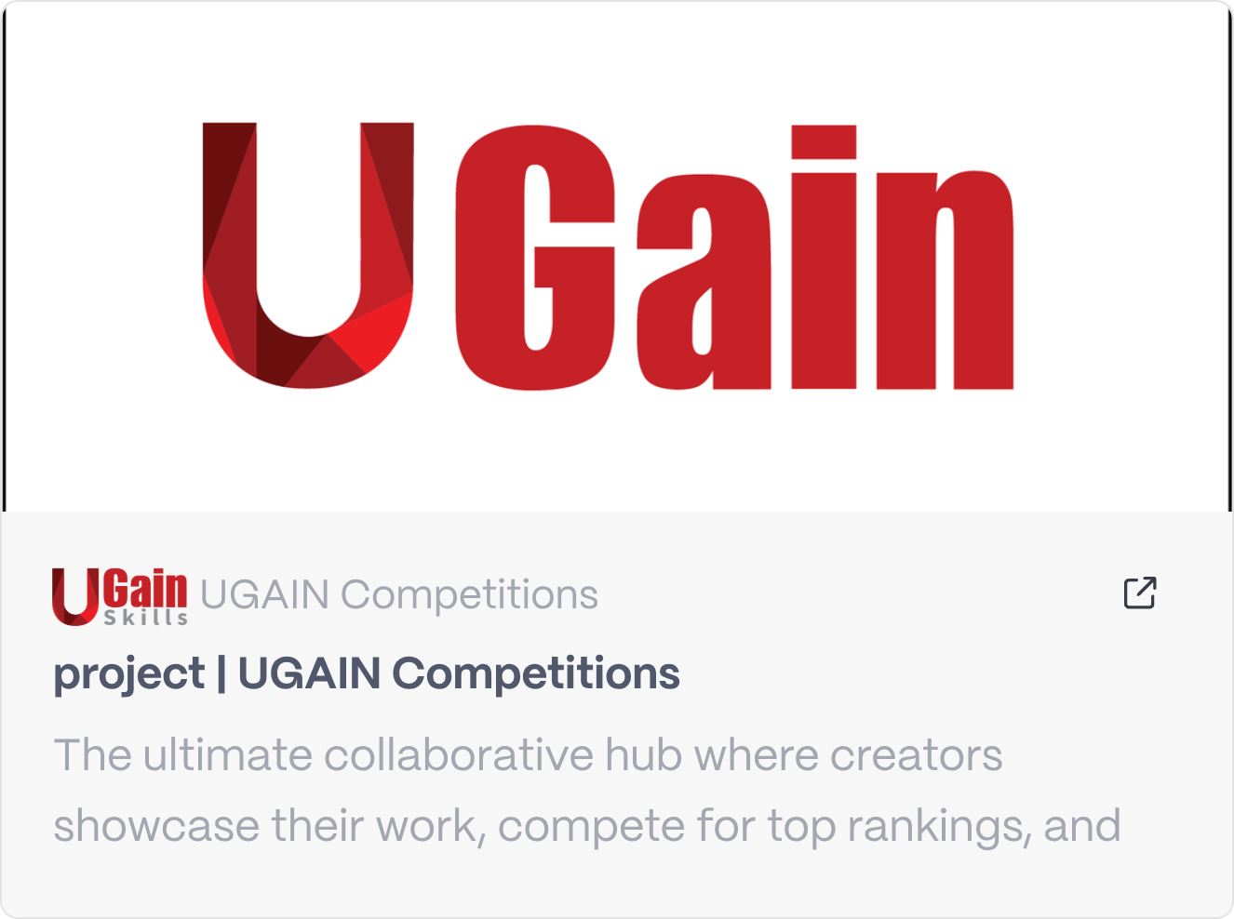
7- AI for Video

Slide 9
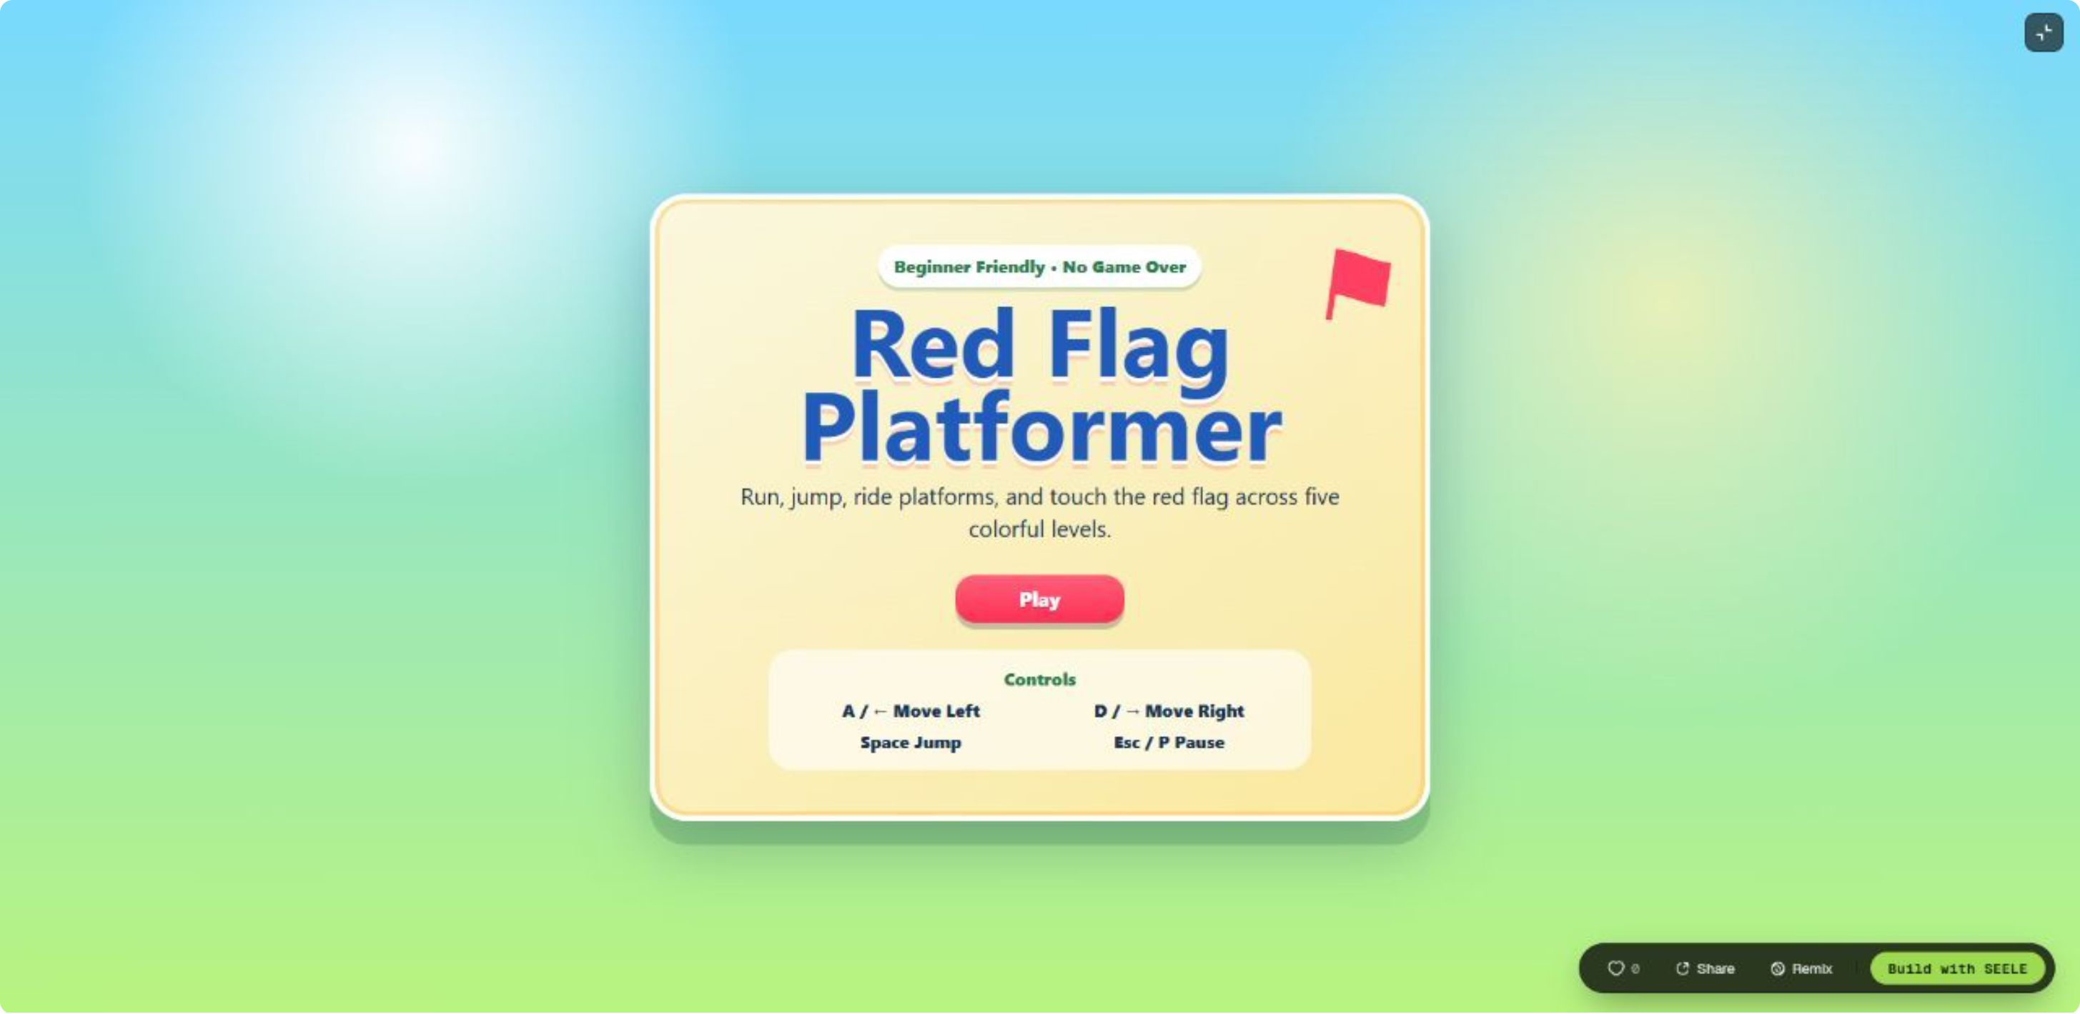
8- AI for Games
https://www.seeles.ai/play/f245aa48-6bbf-4b81-91f3-542e1e91f8b4

Slide 10
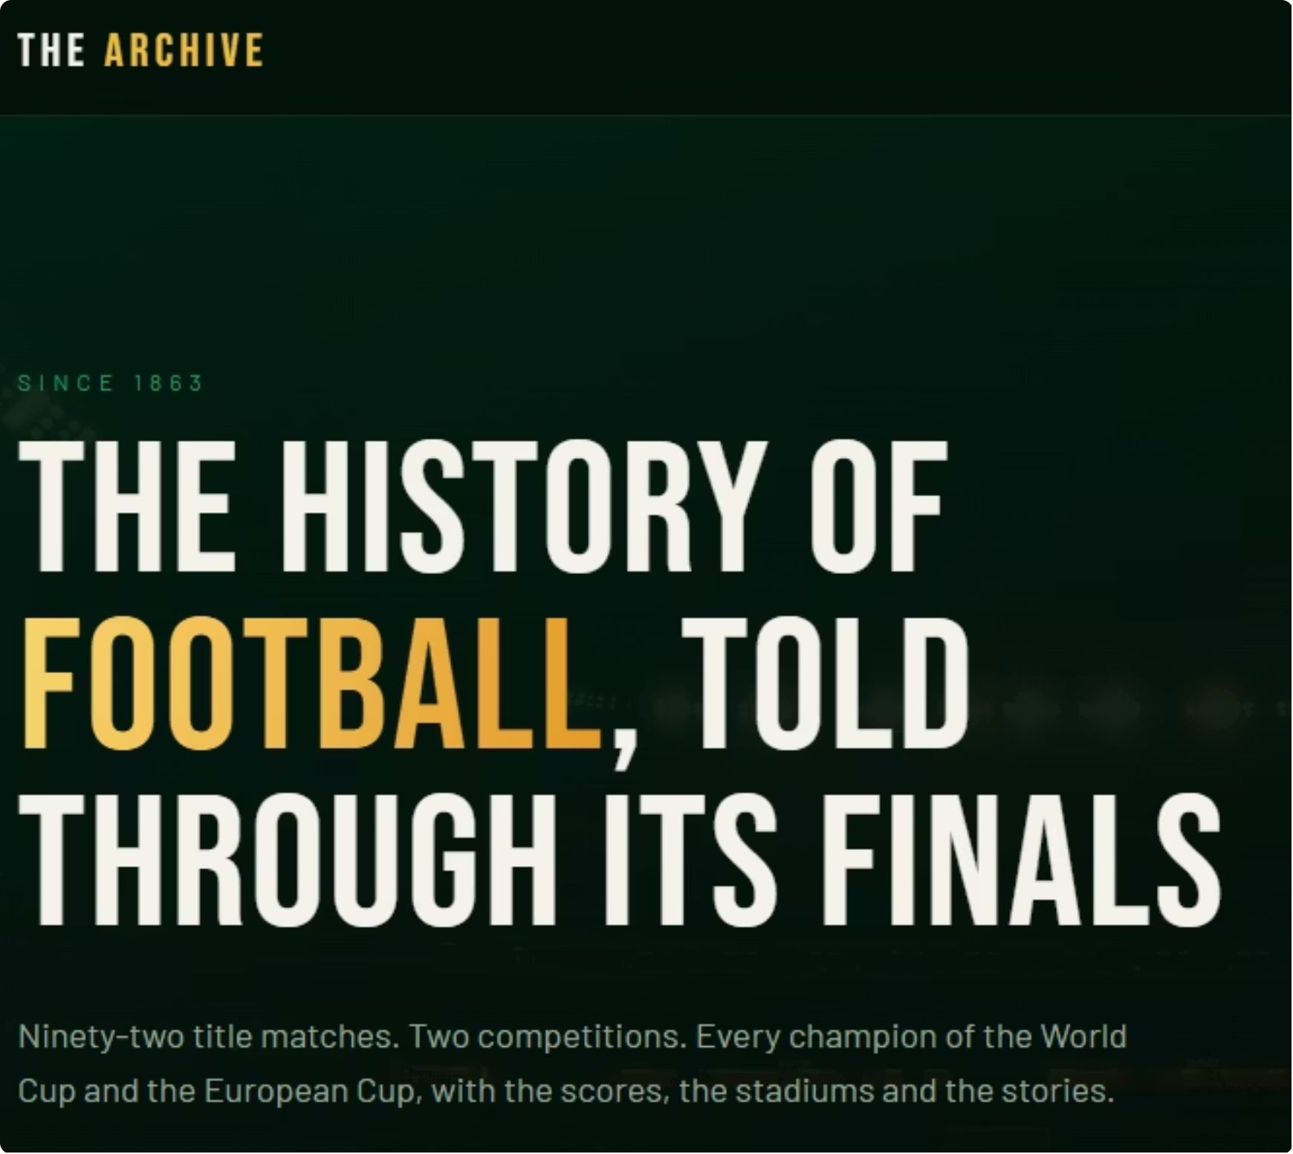
9- AI for Website
https://trophy-trail-chronicles.lovable.app/

