Slide 1
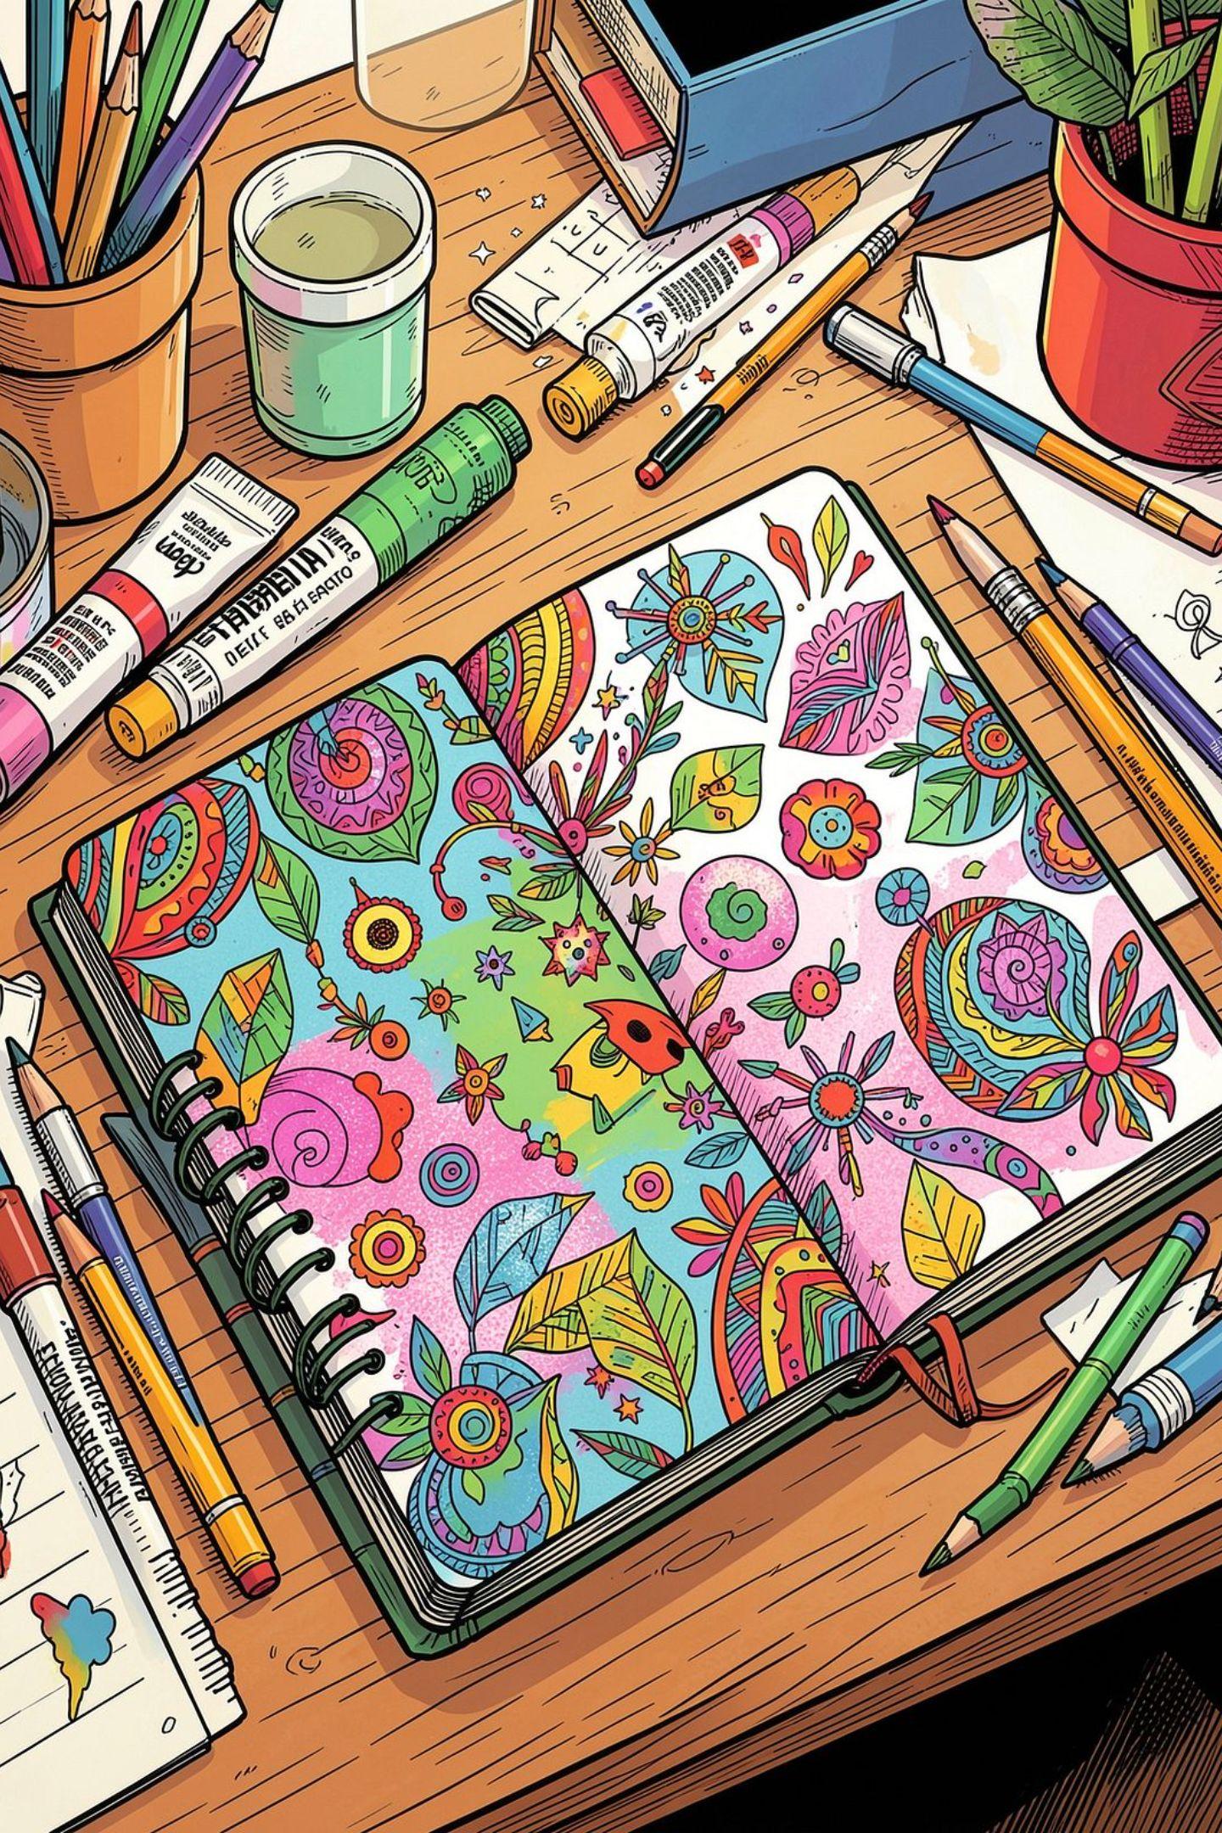
my projects
Ismini

Slide 2

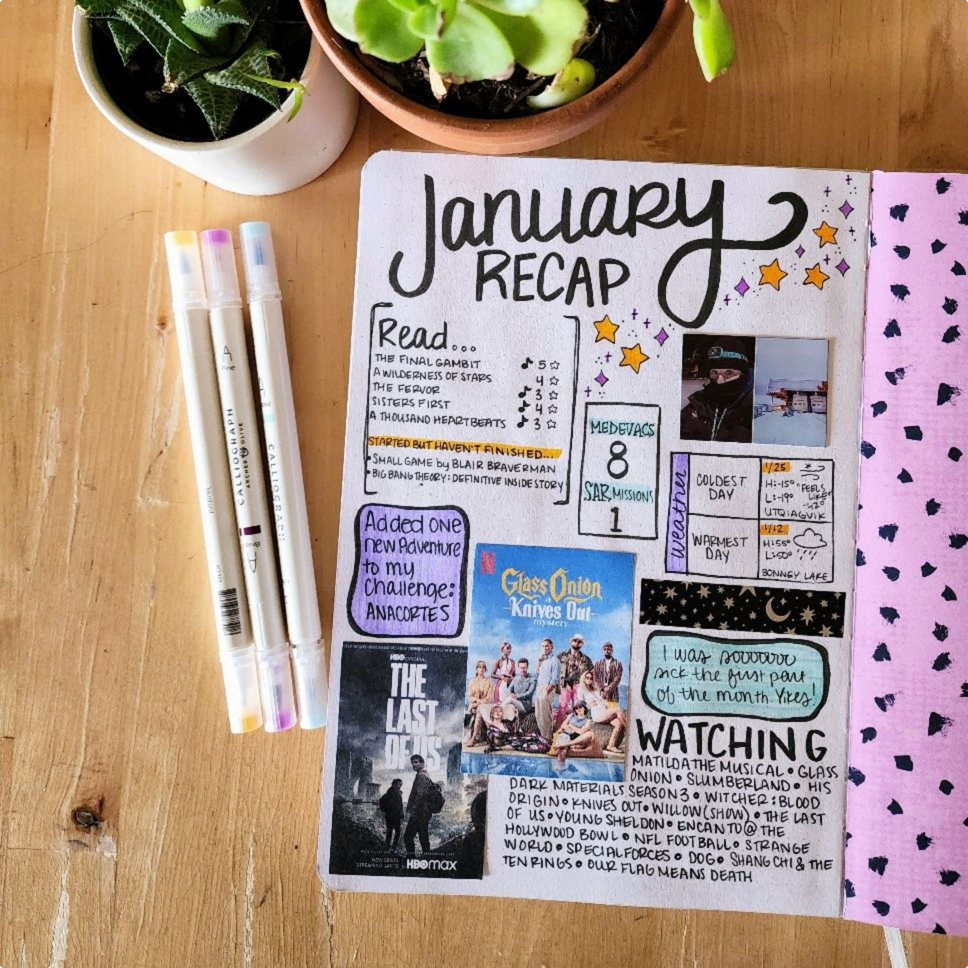

Project idea
Fabric journal fun and creative
My project helps people to read

Slide 3
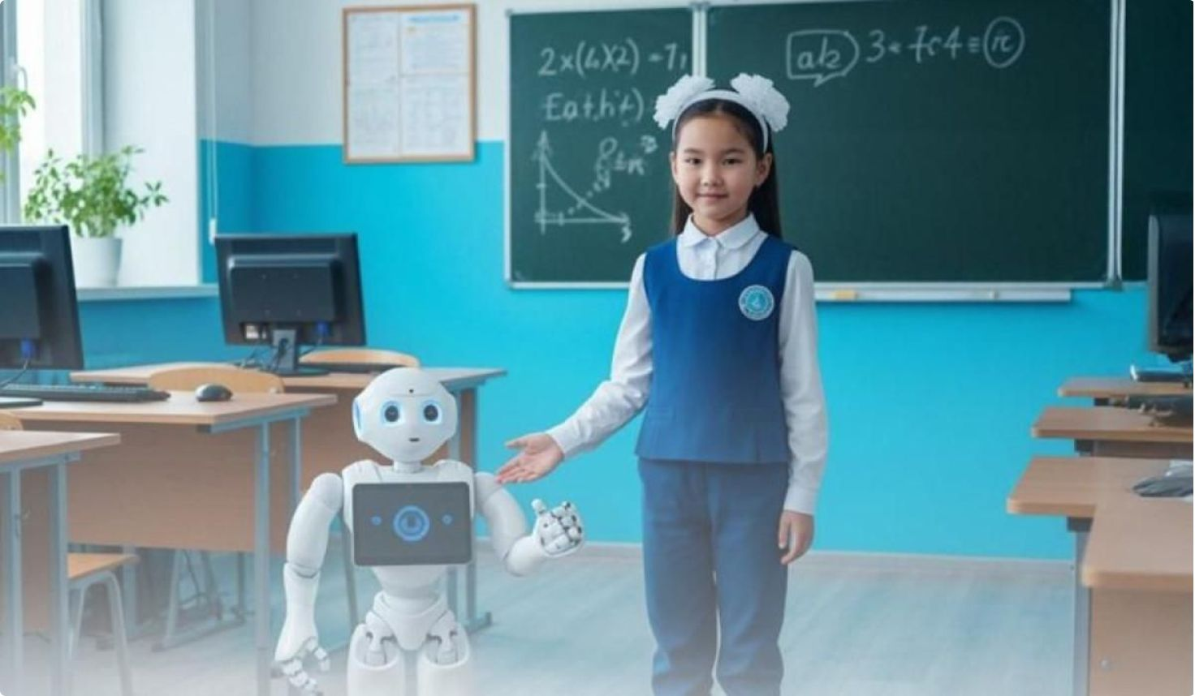

Ai for writing
Maya was a student who loved solving problems, even when they seemed impossible. One rainy afternoon, the power went out during the school science fair. The rooms became dark, and everyone worried that the event would be canceled.
Just then, a small robot named Bolt rolled forward. "I have emergency lights," Bolt said with a cheerful beep.
My project helps people to read this is a small part of the story

Slide 4
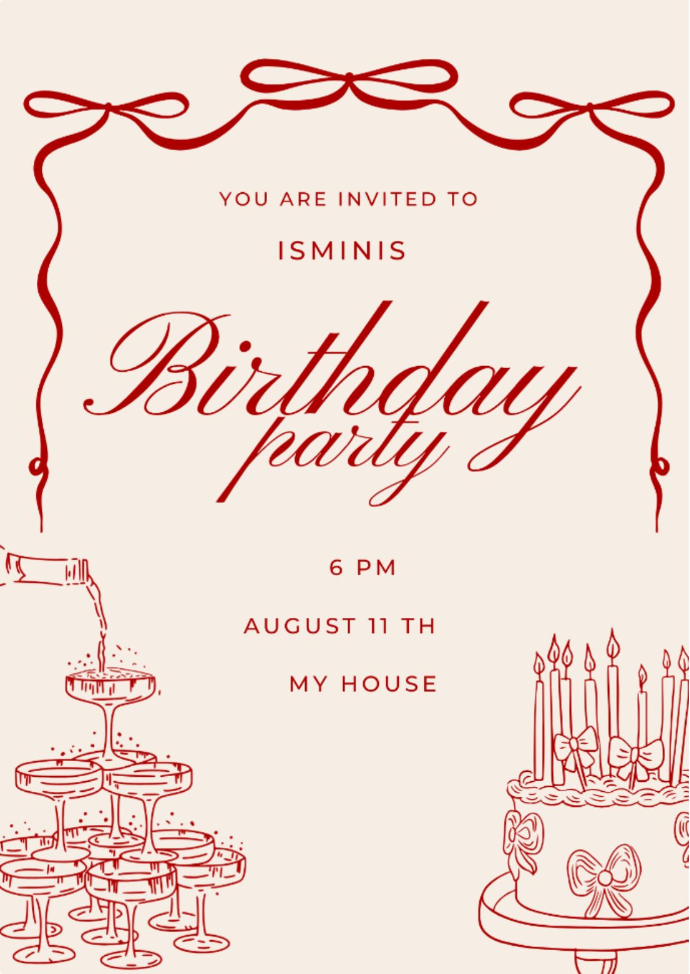

Ai for graphic design
My birthday party invitation
My project helps people to read

Slide 5


Ai for image
FUN CREATIVE IMAGE WITH COLD COLORS AND SOFT CURES SMOOTH TEXTURE , CALM AND EYE CATCHING
My project helps people

Slide 6
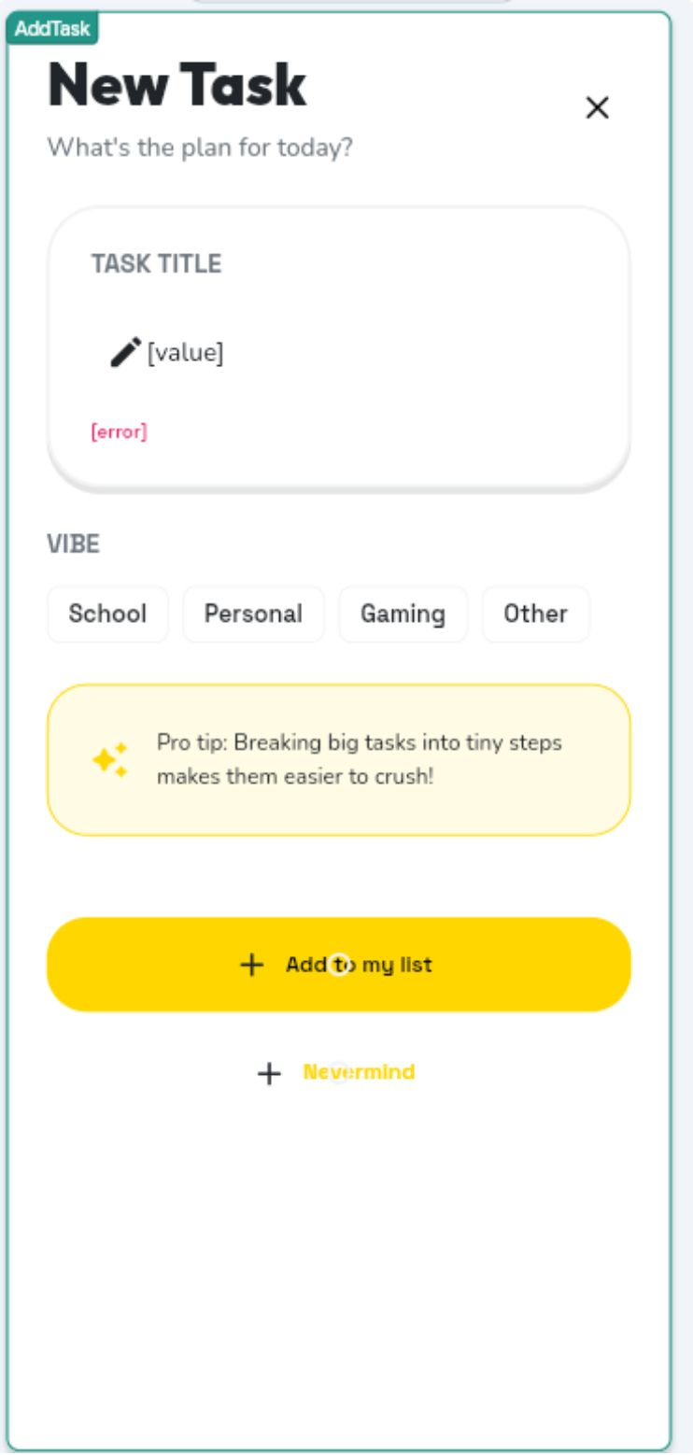
Ai for mobile app
A creative fun app to make sure you finish your tasks and a bonus mood

Slide 7

Ai for music
A pop song made with AI fun and uplifting !!!!

Slide 8
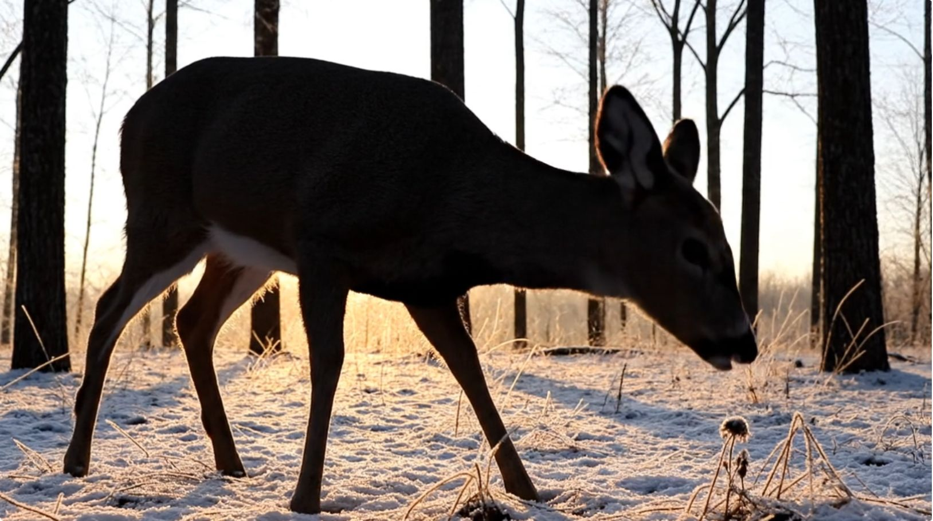
Ai for video
A video made with AI, for nature and relaxation with ambience music

Slide 9
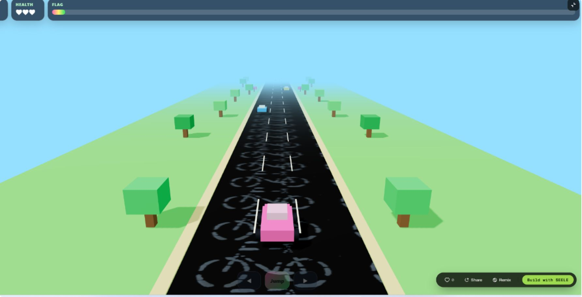
Ai for game
Fun racing game

Slide 10
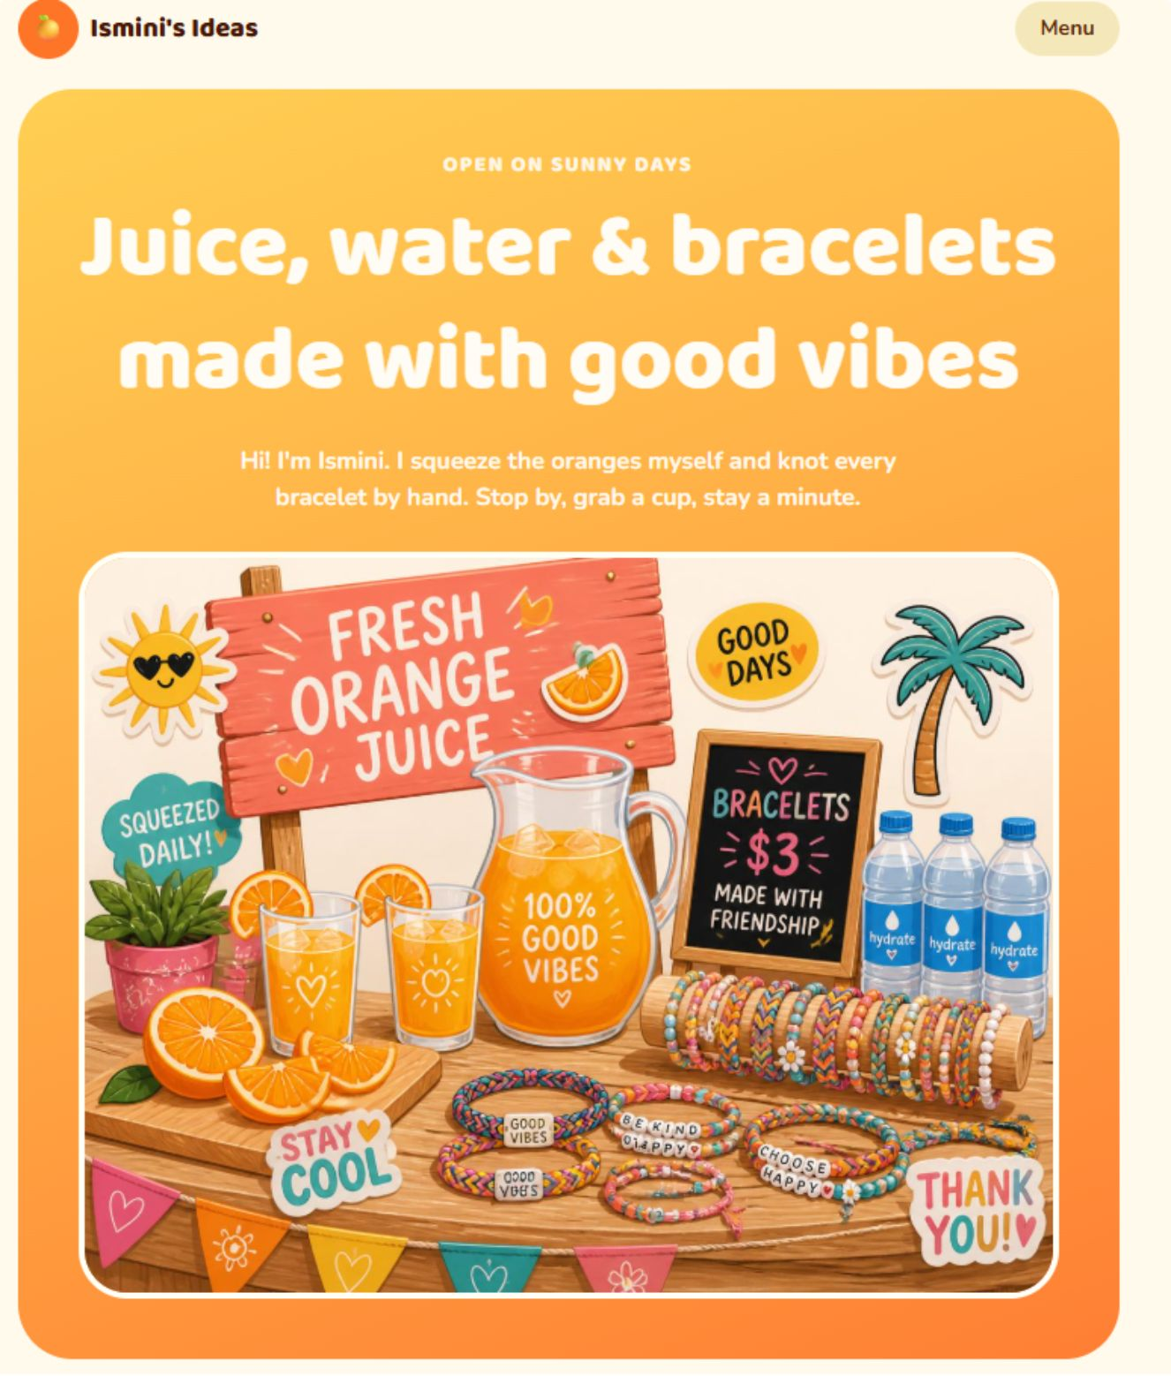
Ai for website
A website for bracelets , juice and more!

